Slide 1
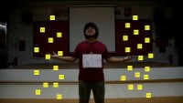
Cell-mediated immunity

