Slide 1



Module 1:
Introduction to Learning Analytics
By
Associate Prof. Ts. Dr. Nurfadhlina Mohd Sharef
Faculty of Computer Science and Information Technology
Universiti Putra Malaysia
nurfadhlina@upm.edu.my

Slide 2
Learning Outcomes and Outline
Learning Outcomes
Outline
At the end of this module, participants will be able to:
Define learning analytics
Explain learning analytics advantages
Describe features of learning analytics
This presentation contains the following outline:
Background
Types of learning analytics
Learning analytics approaches
Data sources
Features of learning analytics
Summary

Slide 3
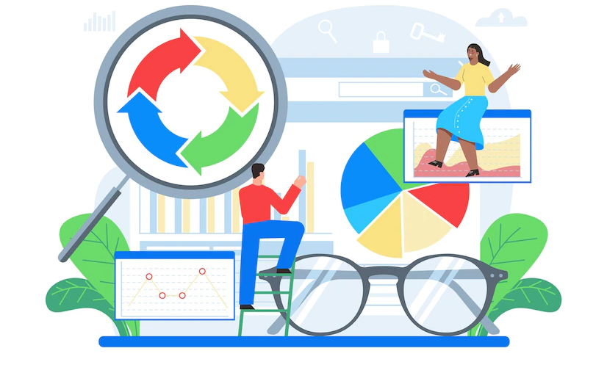
Background
Learning analytics is the measurement, collection, analysis, and reporting of data about learners and their contexts, for purposes of understanding and optimizing learning and the environments in which it occurs.
Learning Analytics have been used to mainly visualize the data about learners, in order to track the learners learning completion and educational programs achievements. Learning analytics could also predict student at risk, so instructors could perform intervention mechanisms such as facilitating extra tutorials or counselling.
Insights are derived based on the patterns identified through the analysis, which may utilize statistical, visualization and machine learning techniques. Decision making using pedagogical knowledge is needed for leveraging the advantage of learning analytics.

Slide 4


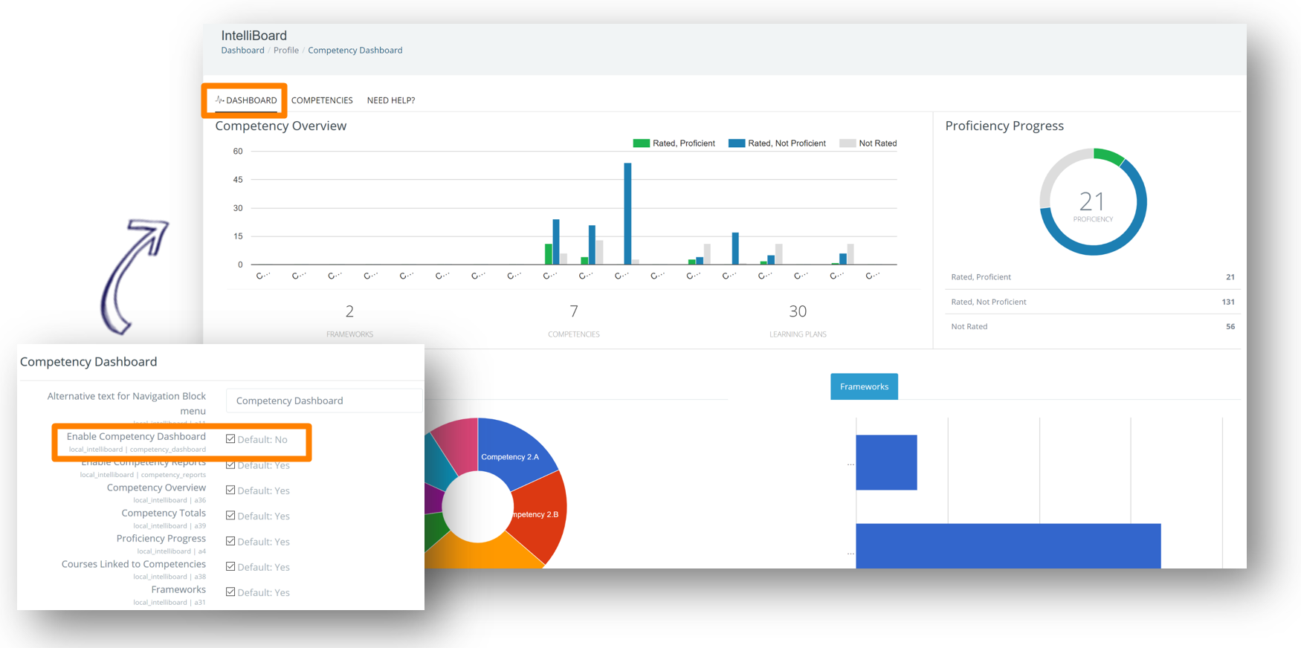
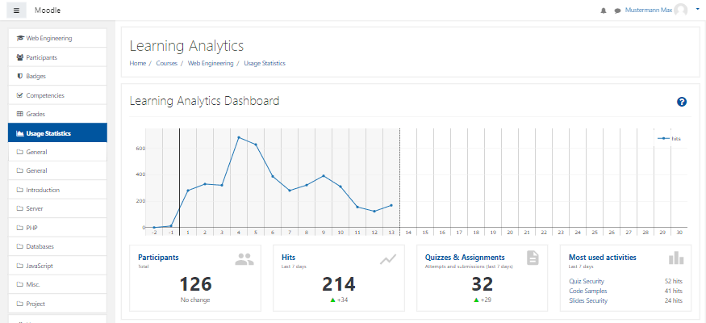
Learning Analytics as a Product
Learning Analytics as a product refers to applications that are made free or commercially available, such as Intelliboard and Moodle. These software are available either as a plugin into a learning management system or as a stand-alone solution. The software collects, measures and reports analyzed data about learners such as the trend of their performance, participation and learning gaps.

Slide 5
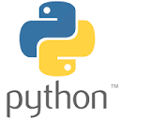




Learning Analytics as a Process
The previous slide explains about learning analytics products, where users benefit from the analyzed information produced by the software.
In contrast, learning Analytics as a process entails its research, development and implementation in an organisation as a continual quality improvement process in educational programs.
Various initiatives have been conducted in learning analytics research, such as:
dashboard and apps design,
development of prediction models using machine learning, and
policy for academic advisory governance
Tools that can be used analyzing data about learning are Microsoft Excel, SPSS, NVIVO, Python, and Power BI; depending on the analysis needs.

Slide 6
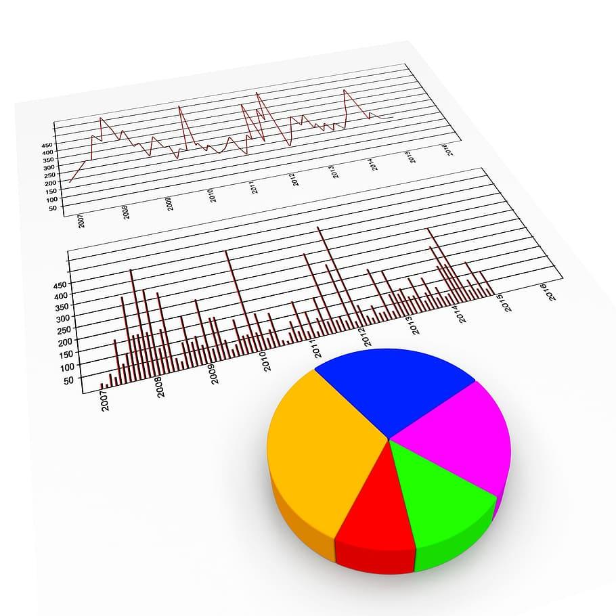


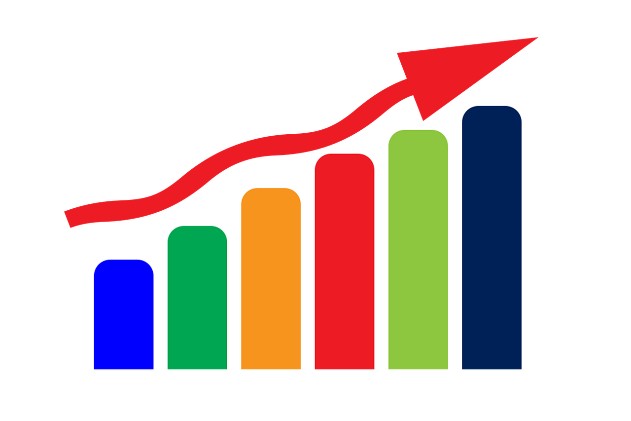
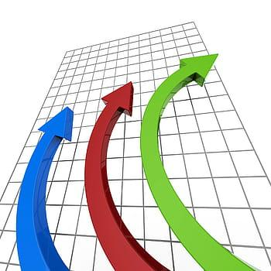
Learning Analytics Approaches
“What has already happened?”
Descriptive
Visualization of learning patterns
“Why something happen?”
Diagnostics
Hypothesizing factors of performance and satisfaction
Predictive
“Who could be at risk?”
Prediction of low achievement or engagement
“What should we do?”
Prescriptive
Recommended action for further teaching and learning

Slide 7
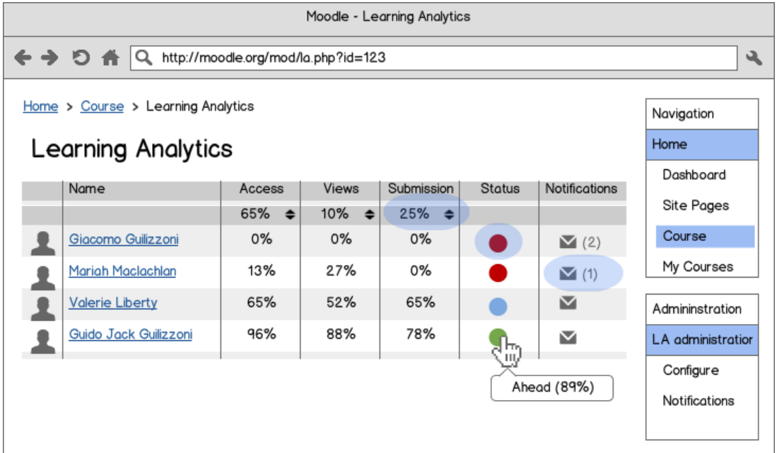
Data sources
Various data can be used for learning analytics:
Marks and grades from assessments such as quiz and assignment
Time spent for learning activities
Choice of materials for learning
Frequency of access to digital educational resources and tools
Participation in learning activities such as posts in forum
Teaching assessment and learning satisfaction survey
Student reflection

Slide 8
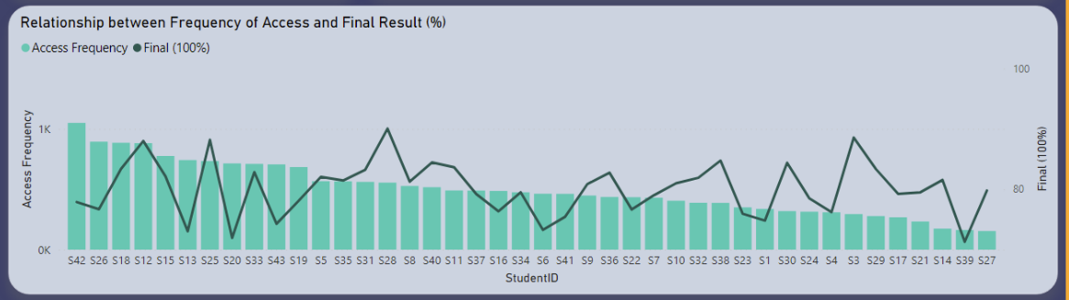
Example analysis
Data for learning analytics can be obtained from the learning management system, records by the instructors, student information system, sensors and student reflection.
Data analysis techniques include visualizing graphs, finding correlation, calculating scores and metrics, and deducing patterns.
For example, from the graph we can deduce that there is no correlation between the frequency of access and final results. This process can be repeated and more information can be digged to further understand about the student’s learning behavior and good recipe of learning styles.

Slide 9

Learning Analytics Features for Students
time spent online
collaborative learning with friends and colleagues
learning recommendation for successful course completion
prefer self/independent learning rather than conventional classroom setting
timeline showing current status and goal
time needed to complete a task or read a text
prompts for self-assessments
further learning recommendations
comparison with fellow students
considering the students personal calendar for appropriate learning recommendations
newsfeed with relevant news matching the learning content
revision of former learning content
feedback for assignments
reminder for deadlines
term scheduler, recommending relevant courses
Reference: Schumacher, C., Ifenthaler, D., (2018), "Features students really expect from learning analytics", Computers in Human Behavior, 78, 397-407

Slide 10

Learning Analytics Features for Instructors
Instructors can apply pedagogical action based on the insights from the analytics
Monitors learners progress
Maneuver teaching strategies or improvise instructional design
Personalize student learning path
Identify individual student performance against class’s average
Identify students with similar performance or learning preferences
Mitigate students at risk

Slide 11
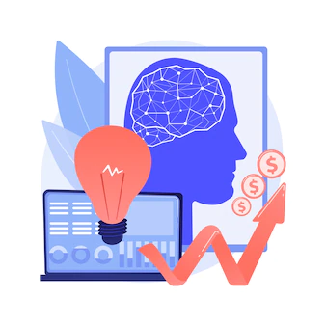
Learning Analytics Features for Institutions
Administrators can perform data-driven decision making based on the gain insights:
Monitor program and student completion
Communicate with learner
Improvise curriculum, promotion and student affairs strategy
Improvise program learning path and system policy

Slide 12
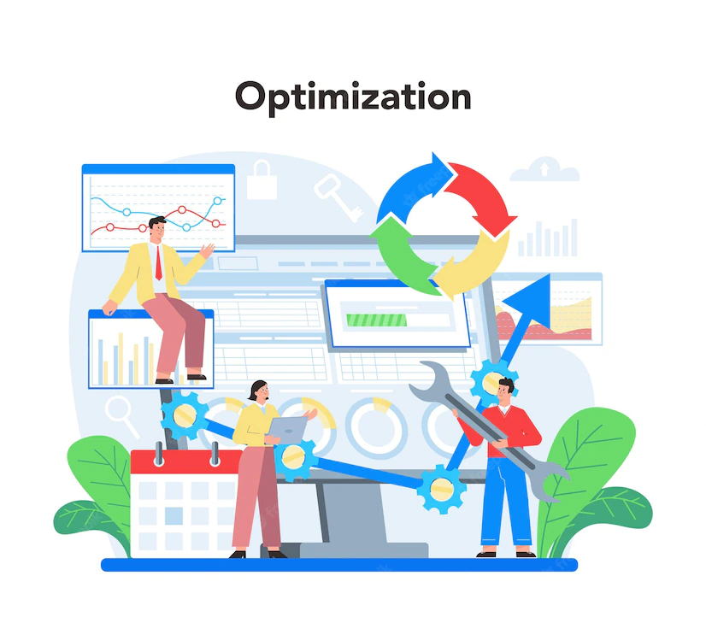
Summary
Learning analytics is a hybrid of pedagogical process and technological application which entails the understanding of learners and their context, by collecting, measuring, reporting and taking action to improve learners experience.
Learning analytics can be performed using descriptive, diagnostics, predictive and prescriptive analytics techniques.
Instructors can trace and improve the teaching approach towards better educational program quality.
Students can get a guide of how to improve their learning strategies.
Institutions can get insight to improve their curriculum.

Slide 13
Thank you
By
Assoc. Prof. Ts. Dr. Nurfadhlina Mohd Sharef
Faculty of Computer Science and Information Technology
Universiti Putra Malaysia
nurfadhlina@upm.edu.my

