Slide 1
Module 2:
Exploratory Data Analysis on Assessment Records using Excel
By
Associate Prof. Ts. Dr. Nurfadhlina Mohd Sharef
Faculty of Computer Science and Information Technology
Universiti Putra Malaysia
nurfadhlina@upm.edu.my

Slide 2
Learning Outcomes
Learning Outcomes and Outline
Outline
At the end of this module, participants will be able to:
Explain functions in Microsoft Excel for data analysis purpose
Use data exploration and visualization functions in Microsoft Excel functions to identify patterns and relationship in data
The outline of this presentation is as follows:
Background
Data Analysis Toolpak
Questioning techniques
Descriptive summary
Conditional formatting
Charting
Recommended charts
Analyze Data function
Quick Analysis function
Histogram
COUNTIF
Deducing Information

Slide 3
Background
Exploratory Data Analysis (EDA) refers to the critical process of performing initial investigations on data so as to discover patterns,to spot anomalies, to test hypothesis and to check assumptions with the help of summary statistics and graphical representations.
EDA is an iterative process comprising the following activities:
Generate questions about your data.
Identify patterns on the data to deduce information.
Search for answers by visualising, transforming, and modelling your data.
Use what you learn to refine your questions and/or generate new questions.
Various techniques can be used for EDA such as data preprocessing, descriptive statistics and visualization.
Tools such as Excel and PowerBI can be used to create dashboard visualizations. Programming languages such as Python and Java can be used to manipulate the data and spot trends.

Slide 4
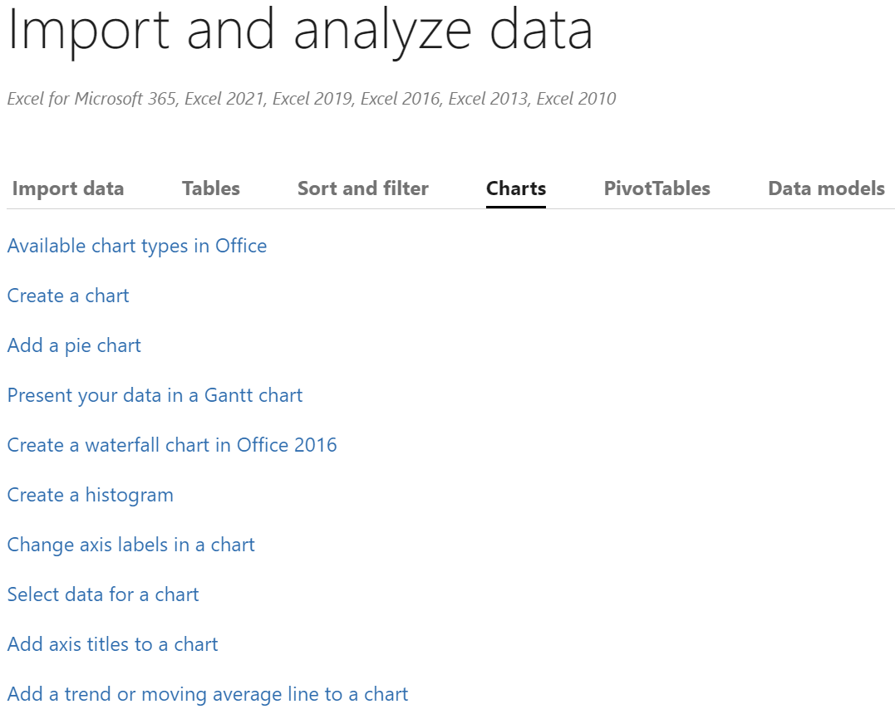
Using Microsoft Excel for Data Analysis
Microsoft Excel is one of, if not the number 1 data analysis software in the world in terms of popularity mainly because its ease of use. It provides the ability to tabulate, analyze and visualize data to assist in data interpretation.
Chart, Formula, Analyze Data function, PivotTable, PivotCharts and Data Analysis Toolpak could support you to identify trends, patterns, and outliers in a data set, facilitating data analysis in seconds and empowering you to understand data through high-level summaries via Excel’s Artificial Intelligence ability.
To visit tutorials in Excel, click the image below.

Slide 5
Using Microsoft Excel for Data Analysis (1)
Data sorting
Data splitting
Functions that can be used in Microsoft Excel to support the data analyst in data analytics purposes
Charting
Pivot Table
Filters
What-if analysis
Formulas
Forecasting

Slide 6
Using Microsoft Excel for Data Analysis (2)
Various charts can be created to plot the trends in the data.
A sparkline is a tiny chart in a worksheet cell that provides a visual representation of data. Use sparklines to show trends in a series of values, such as seasonal increases or decreases, economic cycles, or to highlight maximum and minimum values.
Creating filters in the data allows analyst to focus on specific characteristics.
A pivot table is a table of grouped values that aggregates the individual items of a more extensive table within one or more discrete categories.
This summary might include sums, averages, or other statistics, which the pivot table groups together using a chosen aggregation function applied to the grouped values.

Slide 7
Using Microsoft Excel for Data Analysis (3)
Formulas are equations that can perform calculations, return information, manipulate the contents of other cells, test conditions, and more.
These formulas return a result, even when it is an error.
Among the formulas that are typically used by data analysts are:
SUM: to calculate total
COUNT: to identify frequency
AVERAGE: to get average value
MIN: to identify minimum value
MAX: to identify maximum value
LEN: to count the number of characters
IF: to check a condition
VLOOKUP: to refer a value in a vertical list
INDEX-MATCH: to lookup value dynamically
COUNTIF: to count how many matches the condition

Slide 8
Using Microsoft Excel for Data Analysis (4)
What-If Analysis is the process of changing the values in cells to see how those changes will affect the outcome of formulas on the worksheet. Three kinds of What-If Analysis tools come with Excel: Scenarios, Goal Seek, and Data Tables.
Scenarios and Data tables take sets of input values and determine possible results.
The sorting function allows data to be arranged according to increasing or decreasing order
The filter function is to select some data based on certain characteristics
The Text to Columns function splits data according to occurrence of certain characters

Slide 9
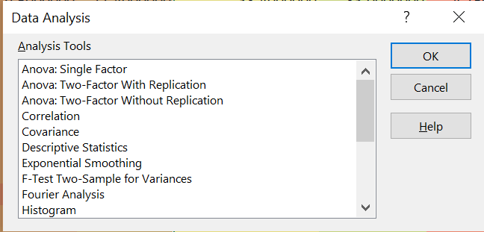
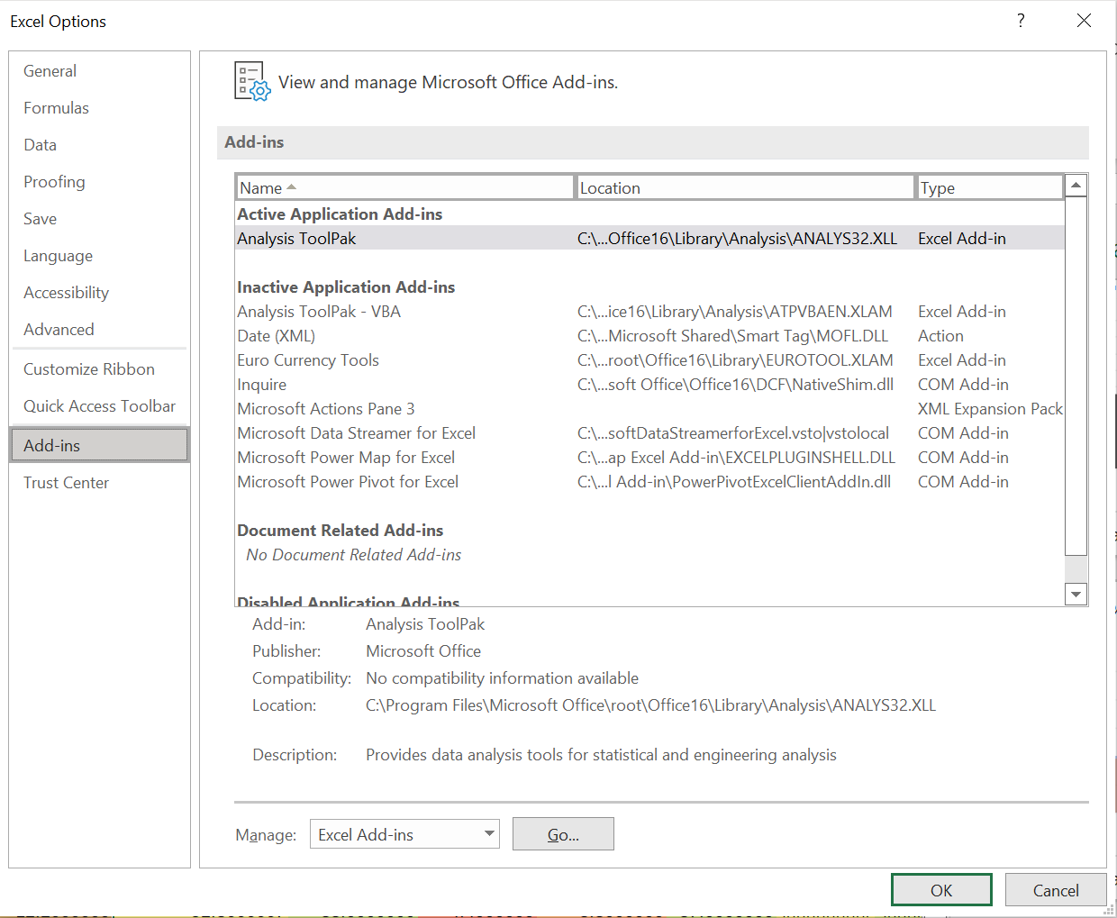
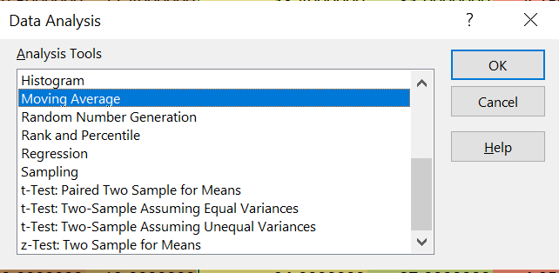
Using Microsoft Excel for Data Analysis (5)
The Data Analysis Toolpak may be added to support for deeper data analysis exercises. To activate this, go to Home>Options>Add-ins.

Slide 10
Activity Time!
Now that you are familiar with the functions that can be used in Microsoft Excel for data analysis, let’s do some activities using Microsoft Excel!
12 activities have been prepared for you, as basic learning analytics task. The remaining of this slide presentation contains step-by-step activities based on an example assessment records.

Slide 11
Example data 1: Assessment Record
Assessment record is one of the most common forms of data used for learning analytics because academic institutions usually keep the scores information. The scores are also used as the key performance indicator, not just for the learner, but also the instructor and the institution.
Therefore, typically some analytics mechanism is adopted such as using Excel template, developing a dedicated system or subscribing to a service.
The figure on the left shows a snippet of recorded scores by a batch of anonymised students in the PutraMOOC data analytics course. The columns are the assessment types and weight, while the rows are the scores for each student.
Download the raw and processed assessment records using the activities in this file at http://putraoer.upm.edu.my/id/eprint/37

Slide 12
Activity 1: Questioning techniques
Create questions as a driver of your exploration. Identify possible visualization and insights to be gained. Examples are as shown below.
Questions | Metrics | Visualization
What is the average, maximum, minimum, variance and stdev marks in each assessment? | Average, Max, Min, var, Stdev | Table
How many students have scored more than the average score in each assessment? | Frequency | Bar chart
How many students obtained more than 65% of each assessment’s maximum score? | Frequency, Percentage | Bar chart
Questions | Metrics | Visualization
Is the performance of each student across assessment consistent? | Percentage | Table
Which assessment has been easy or hard to be scored? | Percentage | Pie chart
What is the student’s strength in terms of cognitive, psychomotor and affective skills? | Average | Heatmap

Slide 13
Activity 2: Descriptive summary
Using the marks file, provide the descriptive summary: average, maximum (max), minimum (min), standard deviation (stdev) and variance (var). These values represent the distribution of the data.
Open the file
Go to Sheet 1
To get the average of values in column B, go to column B, row 45 and enter =AVERAGE(B2:B44)
To get the max among the values in column B, go to column B, row 45 and enter =MAX(B2:B44)
To get the min among the values in column B, go to column B, row 45 and enter =MIN(B2:B44)
To get the var among the values in column B, go to column B, row 45 and enter =VAR(B2:B44)
To get the stdev among the values in column B, go to column B, row 45 and enter =STDEV(B2:B44)

Slide 14
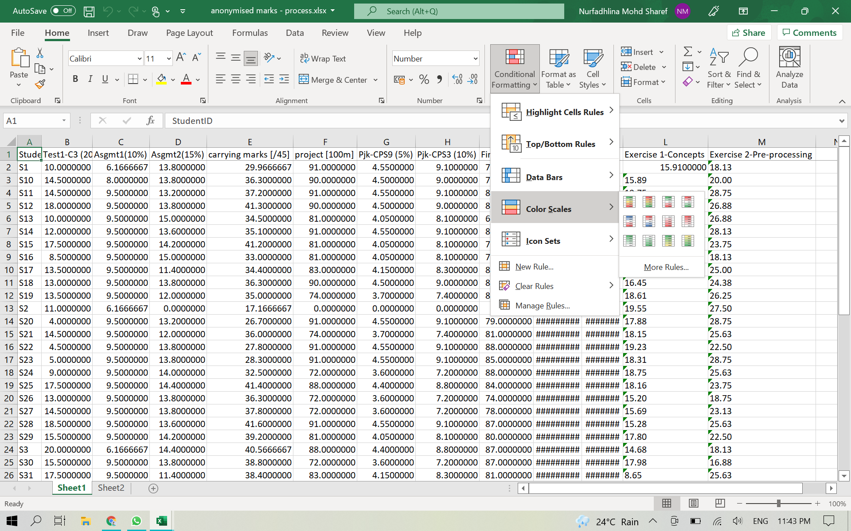
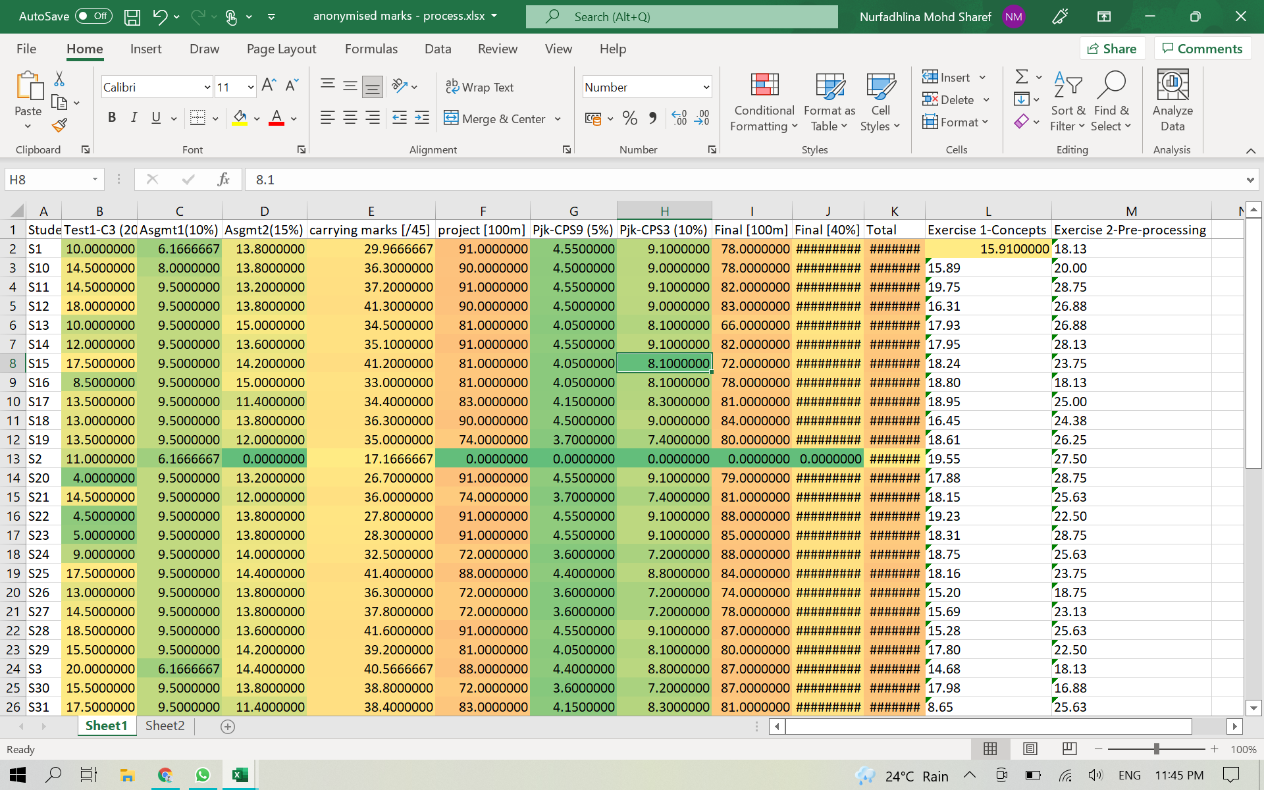
Activity 3: Conditional formatting
2
3
Color scales allows us to see data representation easier visually, using traffic-light color coding
1
5
4
Follow step 1 until 5 in the above figure. Click the corner between column A and row 1. And then, use the Color Scales option in the Conditional Formatting function.

Slide 15
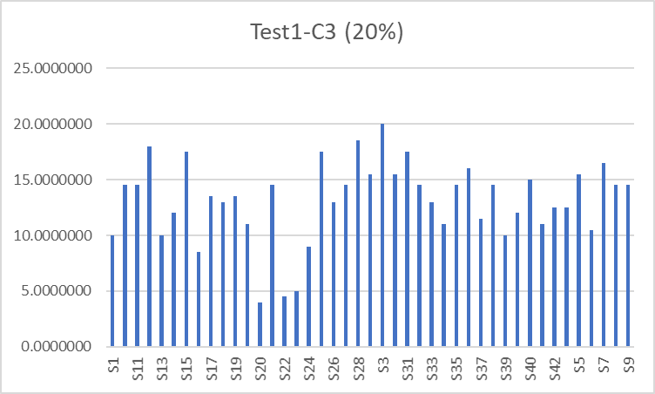
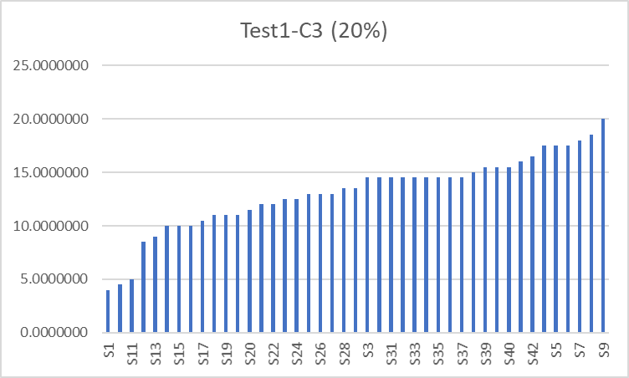
Activity 4: Charting non-sorted and sorted values
We can plot the chart but to read it requires some time, e.g, to find the student with highest mark
Easier reading because the data is sorted. We can also easily see the gap between the minimum and maximum, and identify the median value.

Slide 16
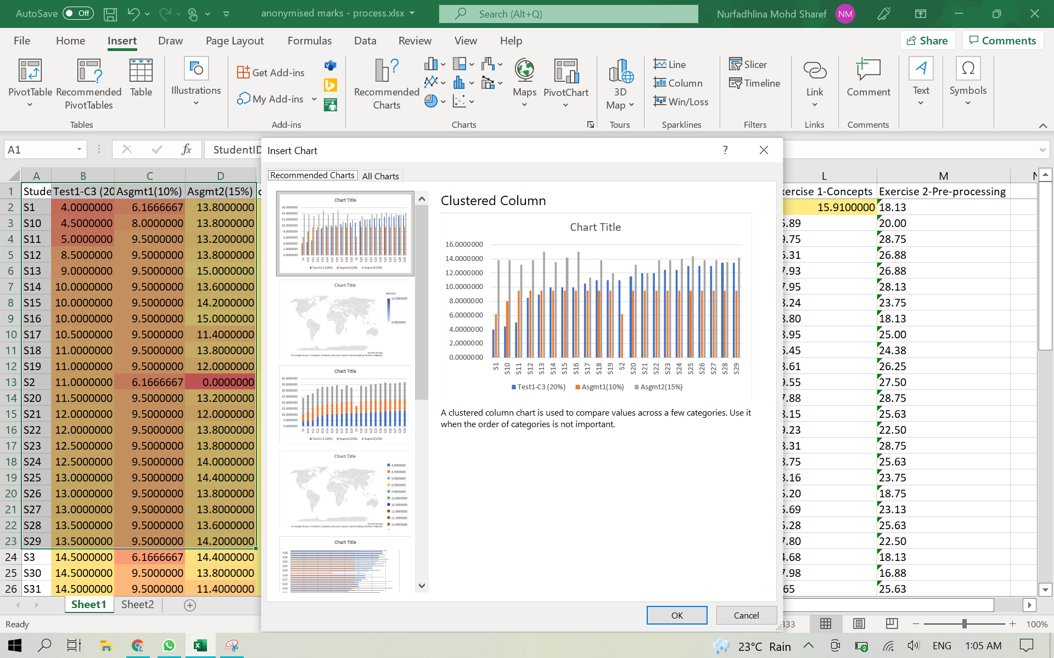
Activity 5: Using Recommended Charts function
Use the Recommended Charts function for some automatically generatable data plotting.

Slide 17
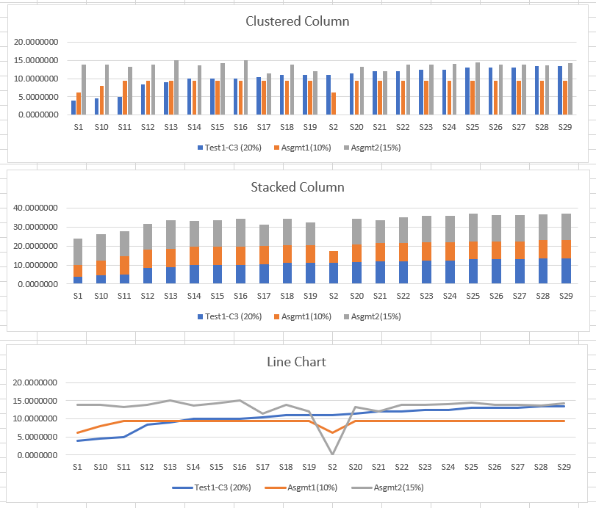
Activity 6: Using Recommended Charts function
Visualization choice matters!
Explore possible visualizations to identify the one that can best suit your need.
The clustered column shows the score in each assessment clearly, but to get information about the sum of some marks, stacked column is the best.
Meanwhile, the Line Chart makes it easy to compare each student’s ranking compared to others in each assessment type.
We can also easily see which student has the highest, and the lowest mark.

Slide 18
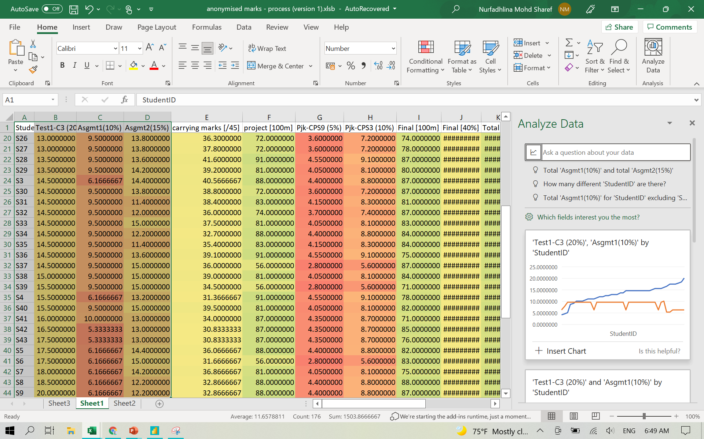
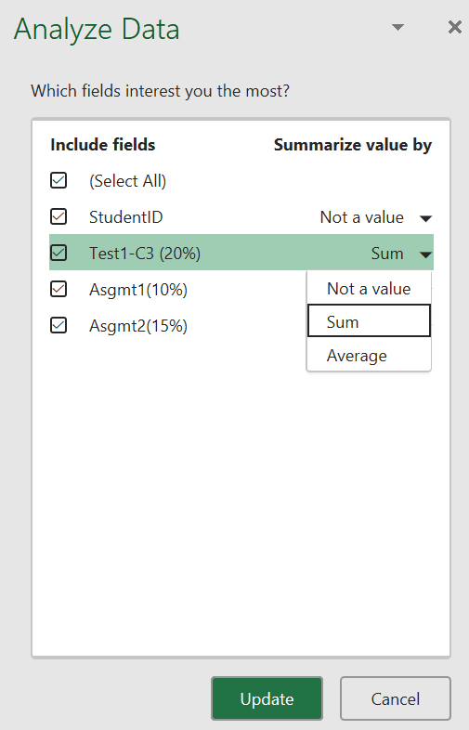
Activity 7: Using Analyze Data function
Simply select a cell in a data range, then select the Analyze Data button on the Home tab.
Analyze Data in Excel will analyze your data, and return interesting visuals about it in a task pane.
Choose any suggested ideas for data analysis listed or insert any readily made chart. You may also customize it using which field interests you the most.

Slide 19
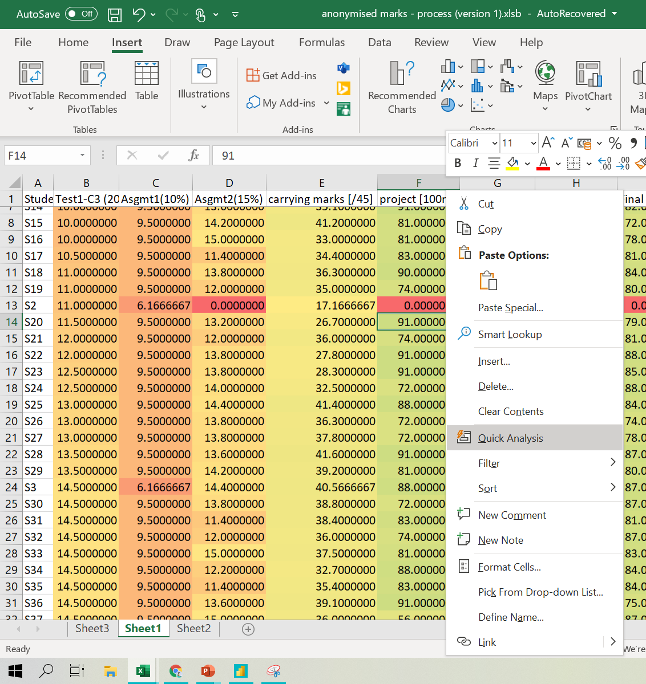
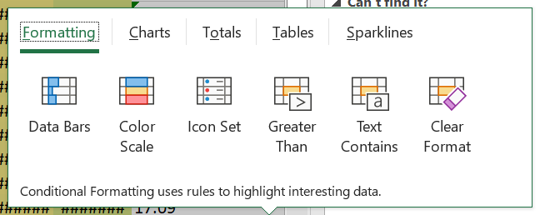
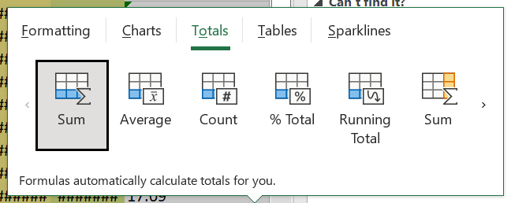
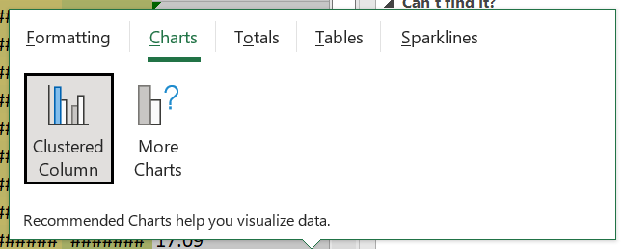
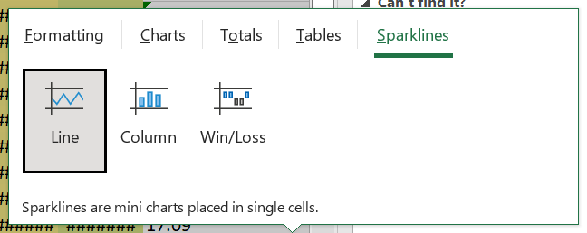
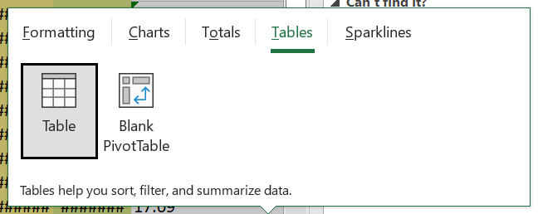
Activity 8: Using Quick Analysis function
Quick Analysis function takes a range of data and helps you pick the perfect chart with just a few commands. Select a range of cells. Select the Quick Analysis button that appears at the bottom right corner of the selected data. Or, press Ctrl + Q.

Slide 20
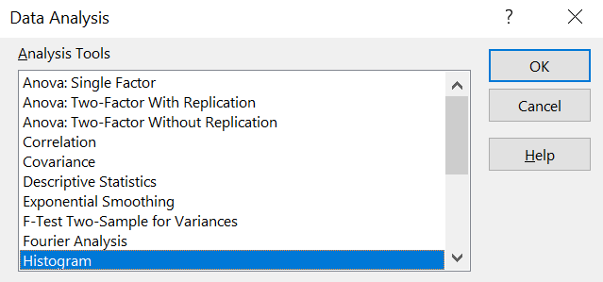
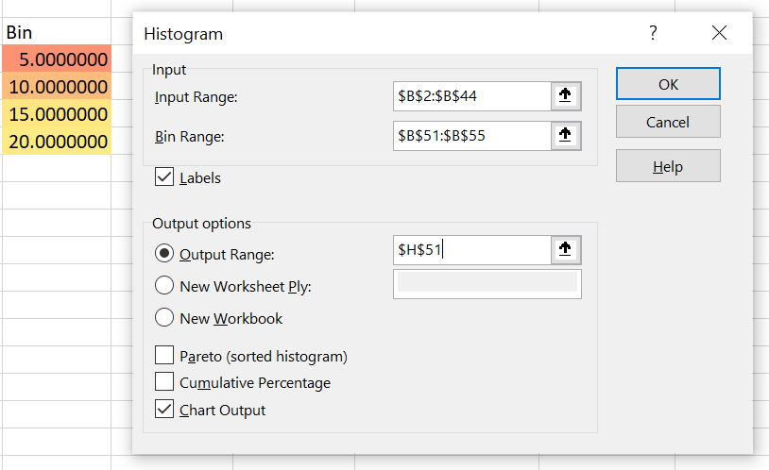
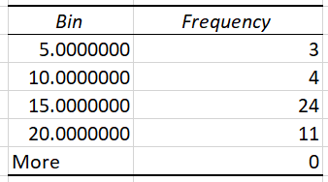
Activity 9: Using Histogram to count frequency of marks of Test1 by a uniformed scale
2
Go to Data>Data Analysis
Histogram is a visualization technique for supporting frequency analysis.
Add the Data Analysis Toolpak to perform Histogram analysis.
To activate this, go to Home>Options>Add-ins.
3
Choose Histogram
1
Prepare the scale for the bin
5
The table of answers will be displayed
4
Provide the variables for creating the Histogram

Slide 21
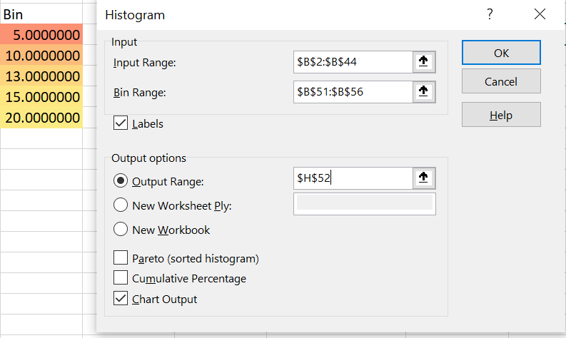
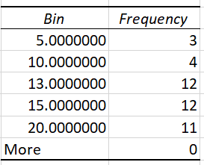
Activity 10: Using Histogram to find frequency of Test1 marks above average
2
1
Go to Data>Data Analysis
Prepare the scale for the bin by placing the average as one of the bin variable
3
Choose Histogram
4
Provide the variables for creating the Histogram
The table of answers will be displayed. We can identify the number of students who obtained marks above average
(average=13)
5

Slide 22
Activity 11: Using COUNTIF to find frequency of Final marks above average
The average value of final marks is 79.19, which indicates that many student almost got grade=A (marks for grade=A is 80).
We can use this information to identify which students have gotten final marks below the average.
Enter this formula in cell N2:
=IF(K2>(AVERAGE(K2:K46)), TRUE, FALSE)
Then, copy this formula and paste into all cells in column K
Next, create a cell for counting the frequency of final marks that is larger than the average value of final marks. Enter this formula:
=COUNTIF(N2:N44,TRUE)
The result is 35, which indicates that 35 out of 42 students have gotten final marks above 35.
The instructor can use this insights to identify students who have gotten the high and low marks (can use average marks as a benchmark). The instructor can reflect the student’s participation, and check whether there has been any comments by the students earlier on their learning problems. The instructor can also perform several additional analytics (using data analysis technique and visuals) to identify the gap among the students, and the trend of score by each student. These information can be used to strategize the next lessons and improve the curricula.

Slide 23
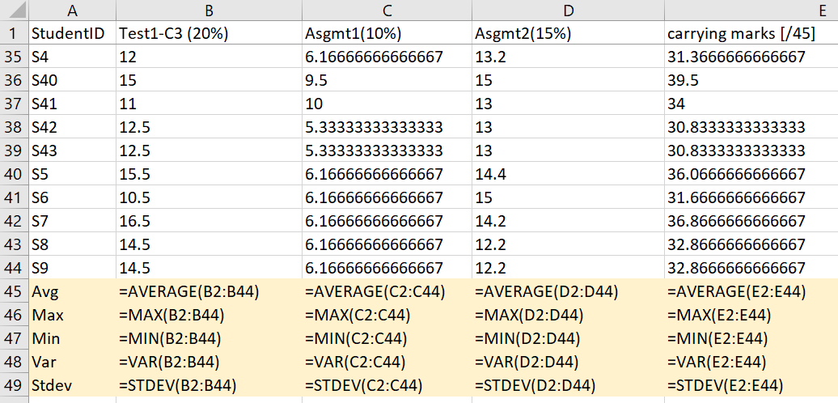
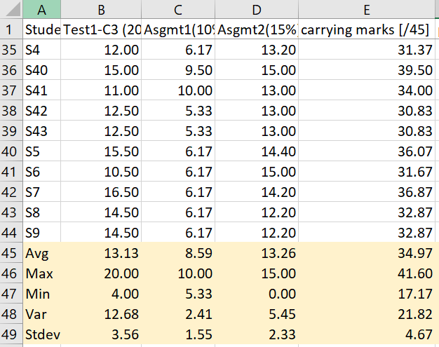
Activity 12: Deducing information
The figures on the right show the formula and the result of the descriptive summary. Based on this data, a few information may be deduced:
In terms of average marks, Asgmt2>Test1>Asgmt1
In terms of variance and Stdev, Test1>Asgmt2>Asgmt1
However, note that, THIS IS WRONG and we CANNOT compare across the assessments because their weight is different. Test1’s weight is 20%, Asgmt1 is 10% and Asgmt2 is 15%.
This is why we need to STANDARDIZE the data so a fair comparison can be made.
In its current state, we can only report separately for each assessment. This limits a deep insight into understanding the student’s performance.
Data standardization and normalization need to also be performed when we compare any two data sources. The next module will explain further on how to do this.

Slide 24
Summary
Exploratory data analysis involves
Understanding your variables
Using visualization technique to dig into the data
Cleaning your dataset
Analyzing relationships between variables

Slide 25
Thank you!
By
Assoc. Prof. Ts. Dr. Nurfadhlina Mohd Sharef
Faculty of Computer Science and Information Technology
Universiti Putra Malaysia
nurfadhlina@upm.edu.my

