Slide 1
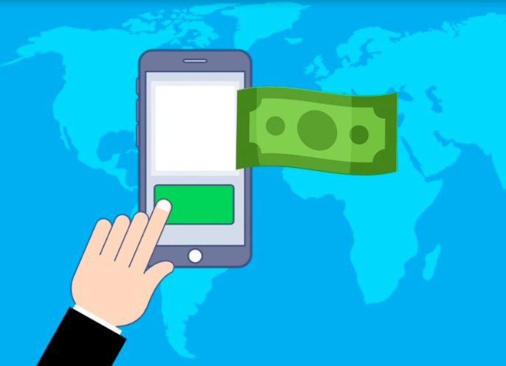

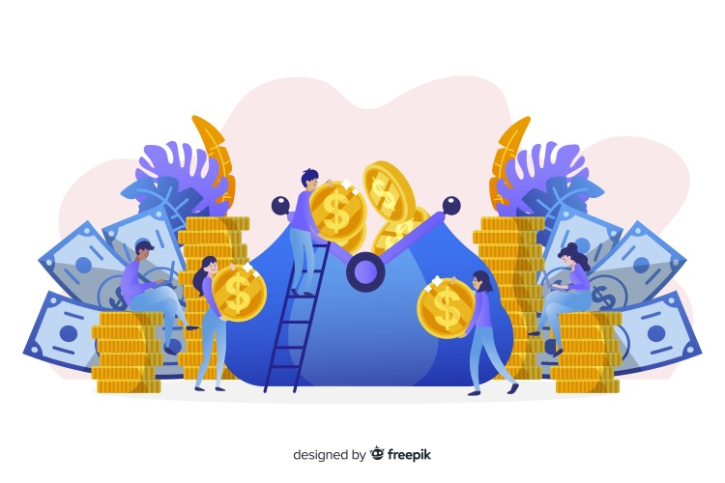


TEKNOLOGI KEWANGAN
(Fintech)
Perbankan & Pembayaran mudah alih
(Mobile banking & payment)
Perdagangan
(Trading)
Teknologi Insurans (InsurTech)
“Crowdfunding platform”
Mata wang digital & blok rantaian (Crytocurrency & Blockchain)
“Robo advisor”
Images by Freepik https://www.freepik.com/
By Zariyawati Mohd Ashhari & Anitha Rosland, Sekolah Perniagaan dan Ekonomi, UPM

