Slide 1
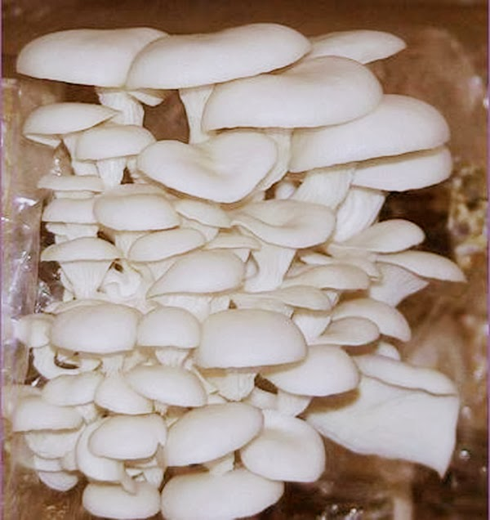
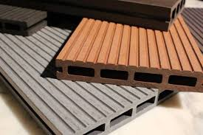
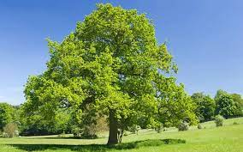
Fungal Biopolymer Composite
Morphological characterization; SEM
Chemical characterization; FTIR/ATR
Fungi
Hydrodynamic characterization; Water contact angle
Germination of fungi mycelia by using fiber waste as substrate
Formation of fungal biopolymer composite
Thermal characterization; DSC/TGA
Mechanical characterization; Universal testing machine
Trunk, fiber leaves, etc.

Slide 2
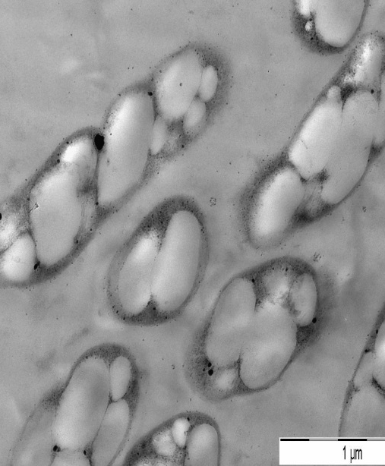
Bacterial Biopolymer (Polyhydroxyalkanoate-PHA)

Slide 3
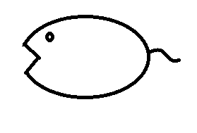
Formation of PHA granules
+
PHA synthase
Hydroxyacyl-CoA
PHA monomer-synthase molecules
PHA granules in bacterial cells
Formation of PHA granules
Micelle model of PHA granules formation

Slide 4
PHA Biochemistry Pathway
Pathway I
Pathway II
Carbon source (Sugars)
Fatty acid degradation
(β-Oxidation)
Carbon source (Fatty acids)
TCA cycle
Acetyl-CoA
Acyl-CoA
PhaA
Acetoacetyl-CoA
3-Ketoacyl-CoA
Enoyl-CoA
PhaB
(R)-3- Hydroxybutyryl- CoA
FabG
(S)-3-Hydroxyacyl-CoA
PhaJ
PhaC
PhaB
PHA
PhaC
(R)-3-Hydroxyacyl-CoA
PhaC
FabD
4-, 5-, 6-Hydroxyalkacyl-CoAs
PhaG
PhaC
(R)-3-Hydroxyacyl-ACP
Other pathways
3-Ketoacyl-ACP
Enoyl-ACP
Related carbon sources
Acyl-ACP
Malonyl-ACP
Malonyl-CoA
Pathway III
Acetyl-CoA
Fatty acid biosynthesis
Carbon source (Sugars)

