Slide 1
Introduction to Forest Recreation and Leisure

Slide 2
What is Recreation?
Recreation is referred to any type of conscious enjoyment
It can happen at any time or any location
Recreation also involves activities whether it is conducted indoor or outdoor.

Slide 3
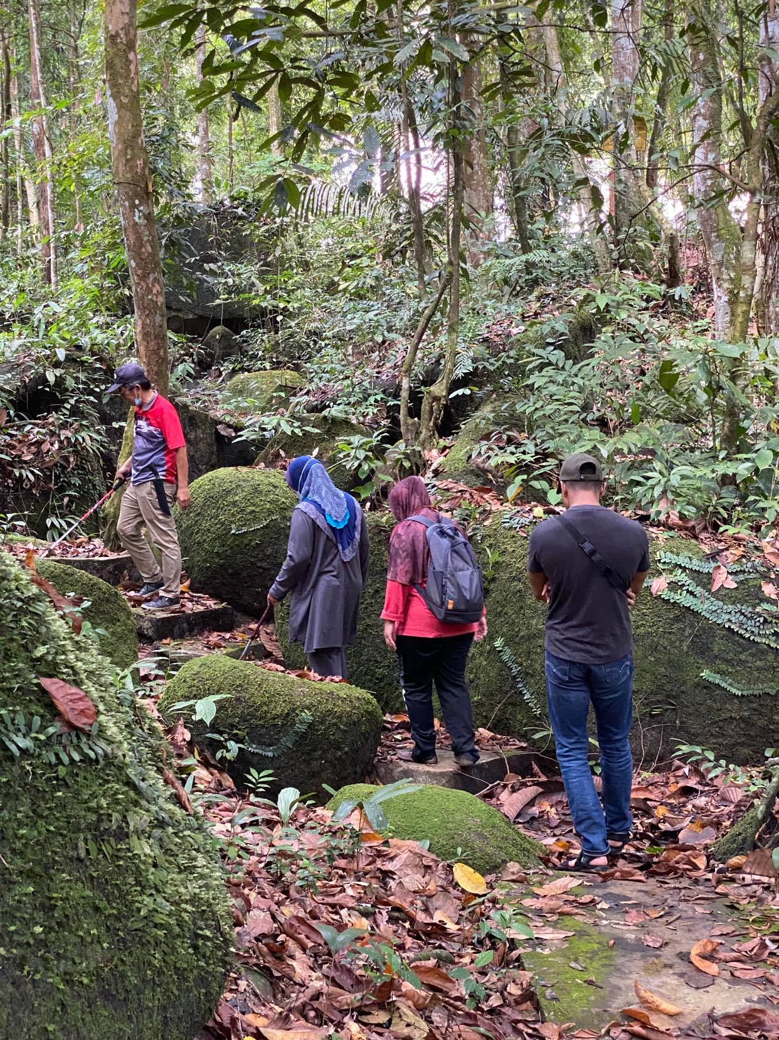
FOREST RECREATION
Forest recreation activities allow visitors to spend time in an outdoor environment amidst some of our natural resources.
The extent of personal satisfaction gained depends more on how valuable the activity is and how long it lasts than how often it is done.

Slide 4
What is Leisure?
Time or opportunity for ease, relaxation, etc.
The time to be used according to our own judgment or choice (Charles K. Brightbill, 1960)
It can involve extensive activity or no activity
Recreation and leisure are highly related, where people need leisure time to get involved in recreation activities.
In society, leisure and recreation may become assets or liability.

Slide 5
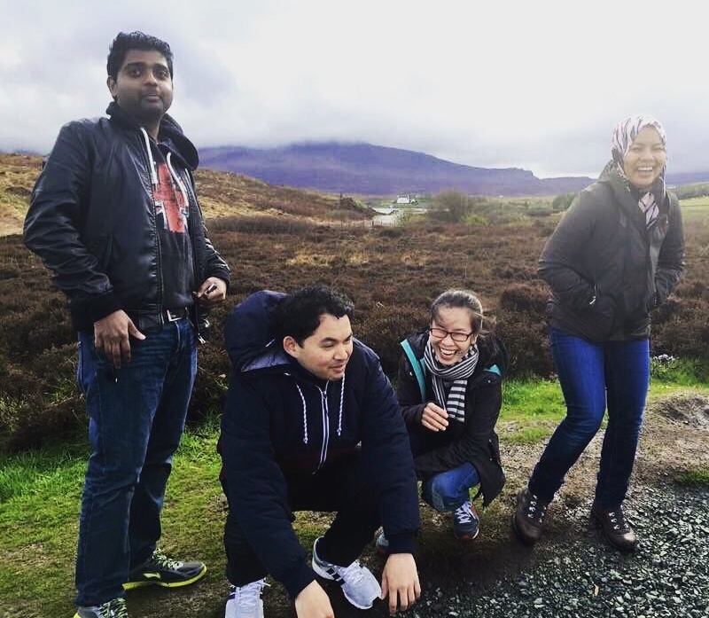
The benefits of leisure and recreation in nature areas
Eventually, after doing recreational activities everybody should have new motivation and energy
Improve quality of life
Opportunity for nature resource manager to provide services.

Slide 6
THANK YOU
Notes:
wi

