Slide 1
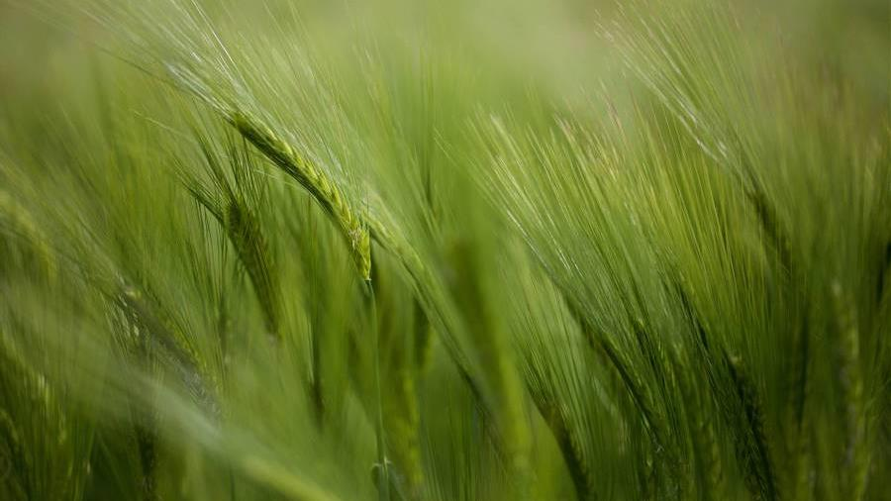
Calculus of variations An Introduction
CHUEI YEE CHEN
Department of Mathematics and Statistics
Faculty of Science
Universiti Putra Malaysia

Slide 2
about
Calculus of variations
One of the classical branches of mathematics. The term is attributed to Euler, who was looking at the work of Lagrange.
Early mathematicians
Dido
Archimedes
Steiner
Fermat
Newton
Bernoulli
Euler
Lagrange

Slide 3
Classical problems in the calculus of variations
Isoperimetric problem (dates back to 200 BC)
Brachistochrone problem (Galileo, 1638)
Fermat’s principle on geometrical optics (1662)
Newton’s problem of minimal resistance (1685)
Biggest possible area of planar domains with fixed perimeter
Fastest path between two points travelled by a point mass under the influence of gravity
The path travelled by a ray of light
using least time.
The shape of a body which renders minimal resistance where the body moves with a given constant velocity through a fluid and the body is described as a graph over a given cross section

Slide 4
Euler-Lagrange equations
1744
1755
Euler published his landmark book, which gave birth to the theory of the calculus of variations.
Systemized the methods used to solve specific problems into a powerful apparatus.
Lagrange wrote to Euler to show how to eliminate the tedious geometrical methods from his process
Known as Lagrange’s variational method.
EULER-LAGRANGE EQUATIONS
Systematic way of dealing with problems in this field.

Slide 5
Model problem
$$\inf\left\{ℱ\left(u\right)=\int_{Ω}{F\left(x, u\left(x\right), Du\left(x\right)\right) dx :u∈X}\right\}$$
$Ω⊂ℝ^{n}$ is a bounded open set, a point in $Ω$ is denoted by $x=\left(x_{1},x_{2},…, x_{n}\right)$;
$u:Ω→ℝ^{N}$ is a vector-valued function of $X$
$$u=\left(u^{1},u^{2},…,u^{N}\right);$$
$Du$ is the Jacobian matrix of $u$ defined as
$$Du={\left(\frac{∂u^{α}}{∂x_{i}}\right)}_{1≤i≤n}^{1≤α≤N}∈ℝ^{N×n};$$
$F:Ω×ℝ^{N}×ℝ^{N×n}→ℝ$ is continuous;
$X$ is the space of admissible functions (example: $u∈C^{1}\left(\overline{Ω}\right)$ with $u=u_{0}$ on $∂Ω$).
AIM: Find a minimizer $\overline{u}∈X$, meaning that
$$ℱ\left(\overline{u}\right)≤ℱ\left(u\right) for all u∈X.$$

Slide 6
MORE EXAMPLES
DIRICHLET INTEGRAL
Minimal surface of revolution
Plateau problem
Microstructure in crystals
Most celebrated problem in the calculus of variations, the corresponding Euler-Lagrange equation reduces to Laplace equation.
Determine the surface with minimal area among all surfaces of
revolution.
A wire loop is dipped into soapy water. When the wire is pulled out, the surface obtained is a
minimal surface.
Apply external force to a material specimen with
internal crystal structure and determine the resulting shape. What is
the total energy of a deformation?

