Slide 1


AI as Decision Partners: How Human Responsibility Shapes AI Use

Slide 2
Part 1
AI and us
AI as Decision Partners: How Human Responsibility Shapes AI Use
Prof Ts. Dr. Nurfadhlina Mohd Sharef

Slide 3




True or False?
Drinking at least 8 glasses of water per day is scientifically proven to be necessary for everyone to maintain optimal health, regardless of age, body size, or activity level.
Correlation automatically implies causation when the relationship is strong and consistent across multiple datasets. Therefore, high correlation coefficients lead researchers to conclude one variable causes the other.
Increasing the amount of training data always improves machine learning model performance, because more data reduces error and guarantees better generalisation.
If a method works well in one situation, it can be applied effectively to all similar situations without significant modification.

Slide 4
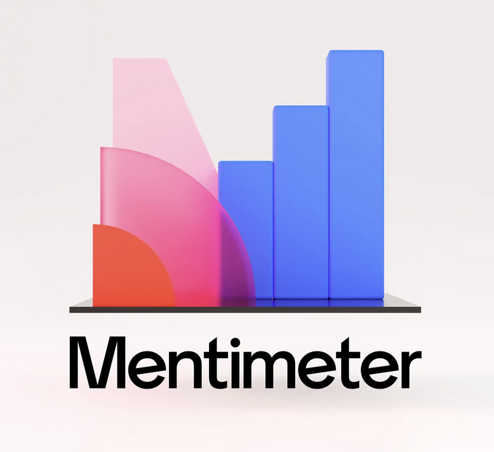
Mentimeter

Slide 5

If AI gives you an answer that looks correct…
and you follow it…
who is responsible if it is wrong?

Slide 6



Slide 7

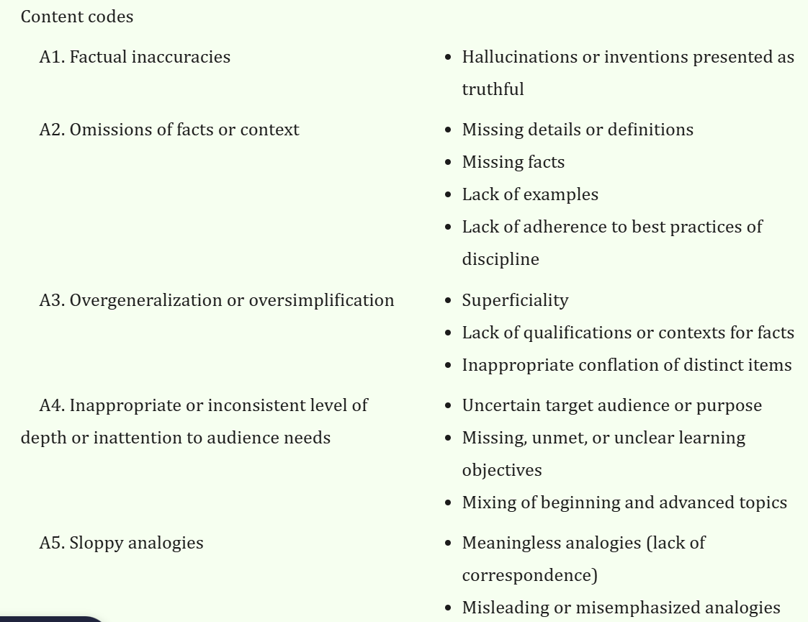
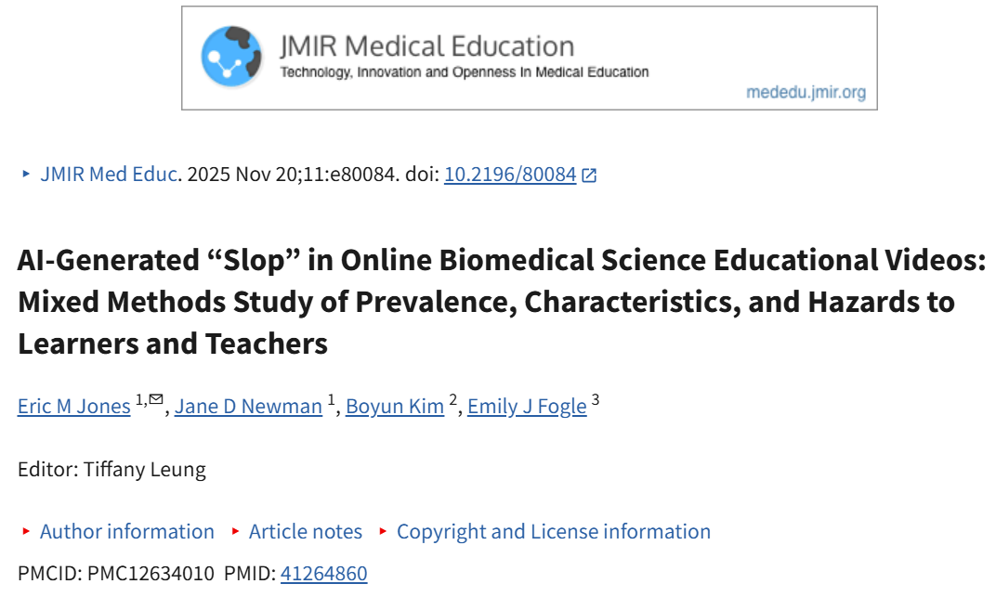

Slide 8
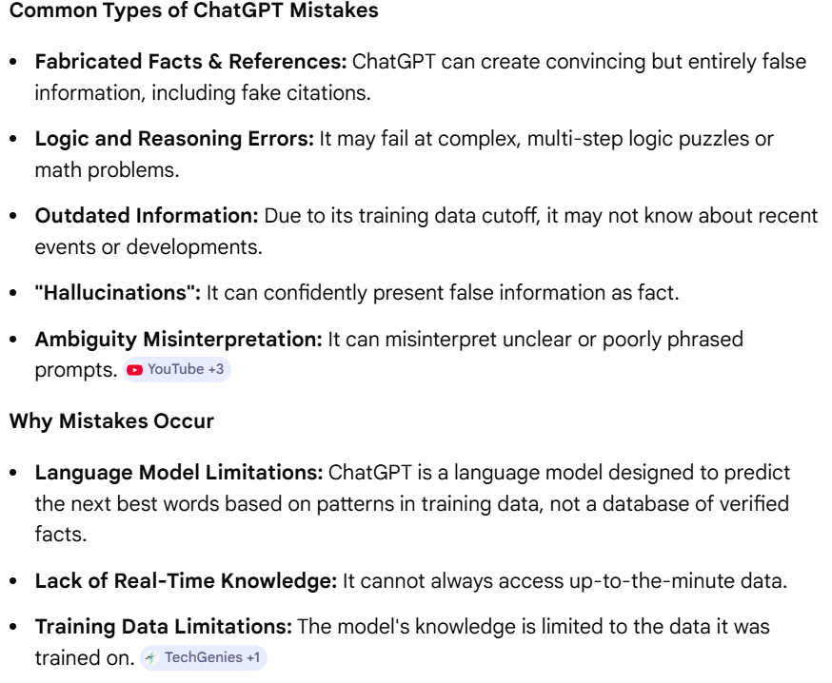

Slide 9





Perception AI
Document extraction (OCR)
Voice-to-text
Image detection (damage, facilities, etc.)
Language AI
Summarization
Drafting memos/letters
FAQ chatbots
Query answering
Translation
Decision AI
Prioritisation
Classification (routing applications/emails)
Prediction (volume, risk, deadlines)
Action / Automation
RPA
Workflow automation
Email triggers
Form pre-filling
Agentic AI
Autonomous task execution
Multi-step workflow agents
Intelligent reminders / monitoring agents

Slide 10








AI Methods | Explanation | Sub-categories
Computer Vision | Applications that analyze visual data to extract meaningful information. | Image recognition, Object detection, Medical imaging analysis
Natural Language Processing (NLP) | Systems that understand, interpret, and generate human language | Text analysis, Machine translation, Sentiment analysis
Speech Recognition and Synthesis | AI that processes spoken language and converts it to text (or vice versa) | Voice assistants, Real-time transcription services, Text-to-speech applications
Robotics | AI-enabled machines capable of performing tasks autonomously or semi-autonomously | Industrial robots, Service robots, Autonomous drones
Planning and Scheduling | AI systems that optimize resource allocation and task management | Workflow optimization, Smart logistics, Autonomous task scheduling
Navigation | AI systems that enable location awareness and route planning | GPS-based navigation systems, Pathfinding for autonomous vehicles, Indoor navigation solutions
Chatbots and Reasoning | Systems capable of interactive conversations and logical decision-making | Virtual assistants, Customer support bots, AI-driven Q&A systems
Machine Learning | Systems that use data to make classification, prediction or clustering | Weather forecasting, Financial market analysis, Predictive maintenance

Slide 11
Part 2
Risk on research values
AI as Decision Partners: How Human Responsibility Shapes AI Use
Prof Ts. Dr. Nurfadhlina Mohd Sharef

Slide 12


WHO REALLY HOLDS POWER WHEN AI IS USED?
Ability to question AI outputs
Ability to choose among alternatives
Ability to override or reject AI advice
Clarity of responsibility
Sharef, N.M. (2026)

Slide 13
AI Threat | Responsible AI Focus
Loss of human agency | Human oversight, human-in-the-loop, autonomy
Dehumanisation | Human dignity, respect for persons
Discrimination | Fairness, non-discrimination, equity
Context blindness | Sector-native validation, contextual integrity
Privacy erosion | Data protection, consent, data governance
Data exploitation | Data agency, benefit sharing
Accountability vacuum | Accountability, auditability, traceability
Lack of contestability | Explainability, right to challenge
Power concentration | Governance, transparency, checks and balances
Environmental harm | Sustainability, proportionality
Behavioural manipulation | Transparency, user awareness
Surveillance creep | Privacy-by-design, necessity & proportionality
AI Threats vs Responsible AI
Sharef, N.M. (2026)

Slide 14
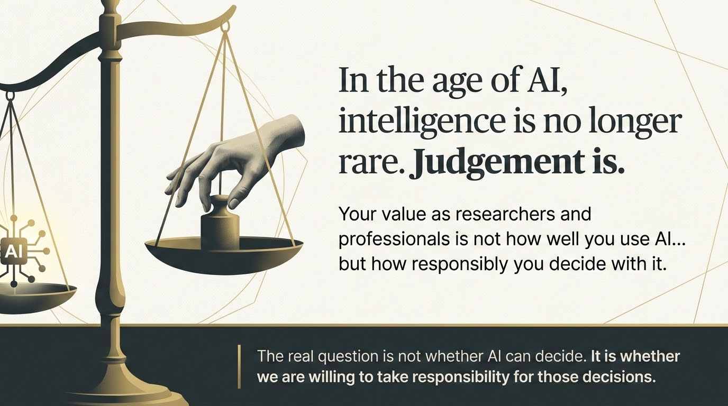

Slide 15
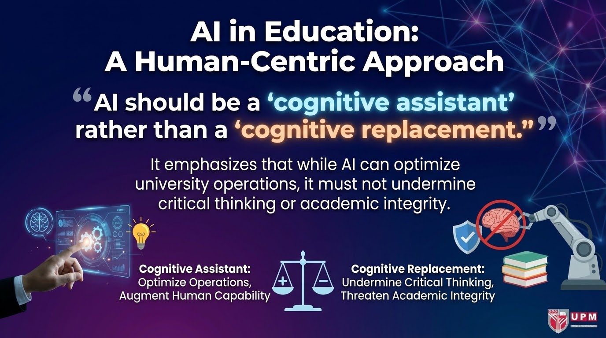

Slide 16
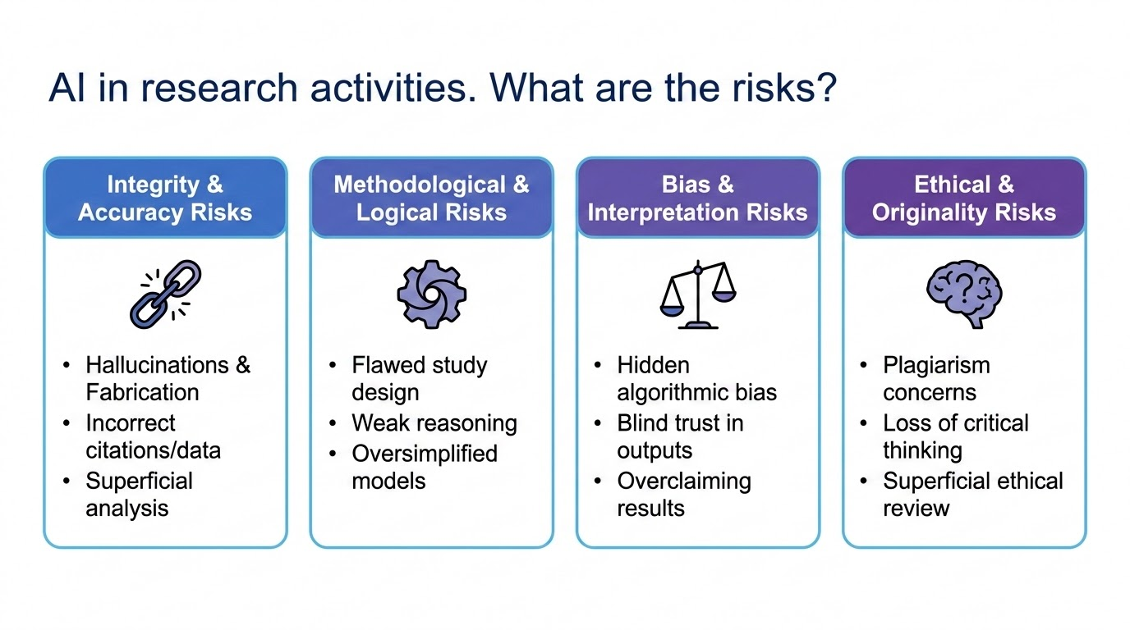

Slide 17
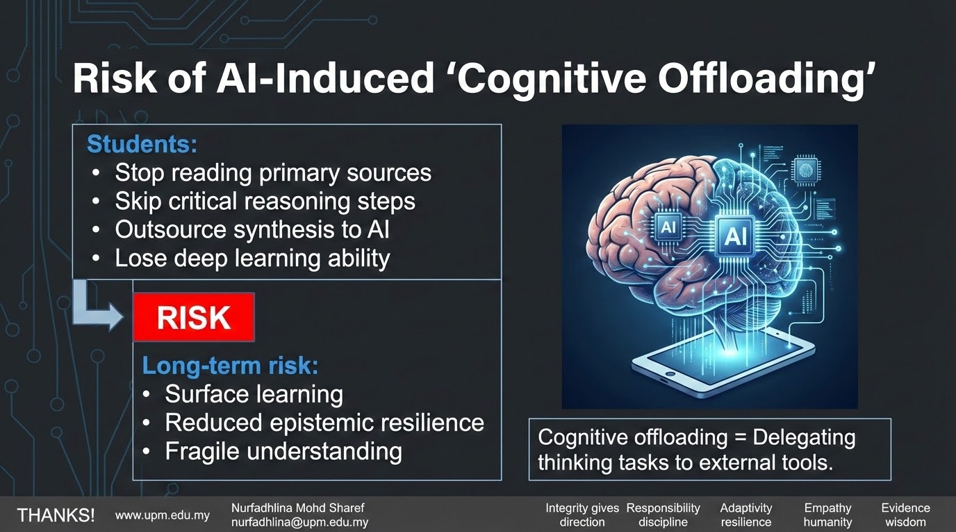

Slide 18

Evaluating AI automation in science
Level Zero : absence of automation in science.
Level One: human scientists still describe the problem in full, but machines do some data manipulation or calculation. Some commentators date [data science]
Level Two: important aspect of the discovery cycle is fully automated. eg, the simulation or extraction of knowledge, or the testing of propositions where humans are still required for some of the most important aspects of the full experimental cycle but that at least one pathway has been fully automated. [machine learning]
Level Three: human scientists are still giving the AI the hypothesis and solution spaces, AI perform model selection and generation, eg theorem proving by human. [auto machine learning]
Level Four: humans would still need to feed the AI system with all the initial information and data it needs, AI generate and explore the hypothesis space but at least one aspect of the discovery cycle would not be fully automated. This is the stage where science, especially experimental science, can be greatly accelerated. For such machines, this involves almost no human intervention except for providing consumables. [auto robot scientist]
Level Five: full automation, covering all levels of discovery and with no human intervention
Src: https://www.oecd-ilibrary.org/docserver/63faa850-en.pdf?expires=1697773442&id=id&accname=guest&checksum=72F314F02D022A2A9921EAF531D62123

Slide 19
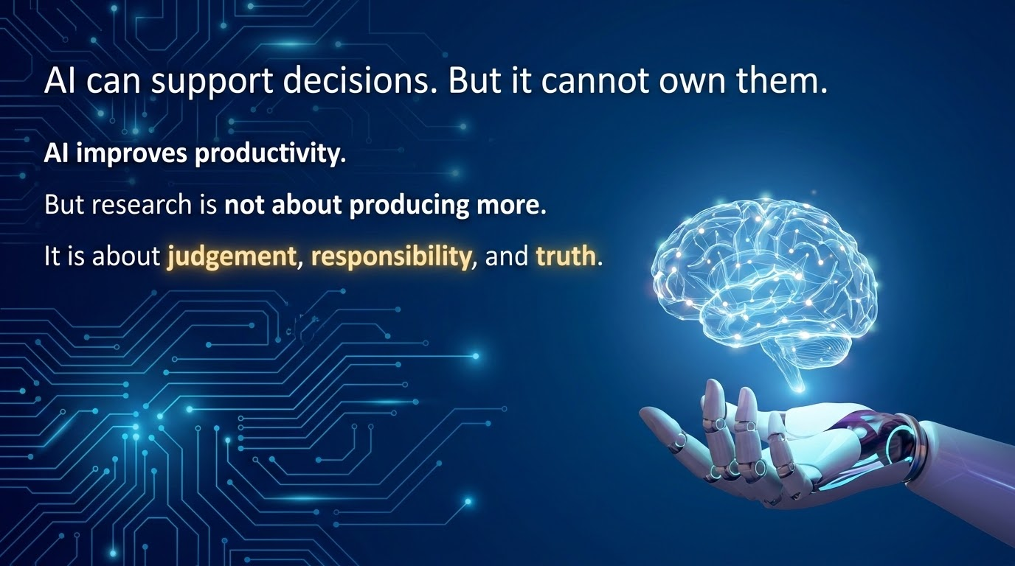

Slide 20

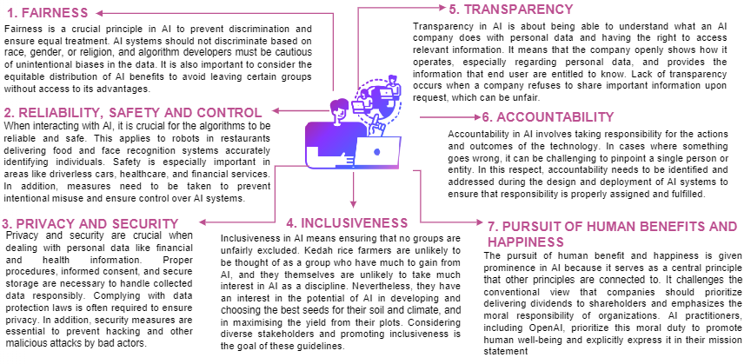
7 Principles of Responsible AI

Slide 21

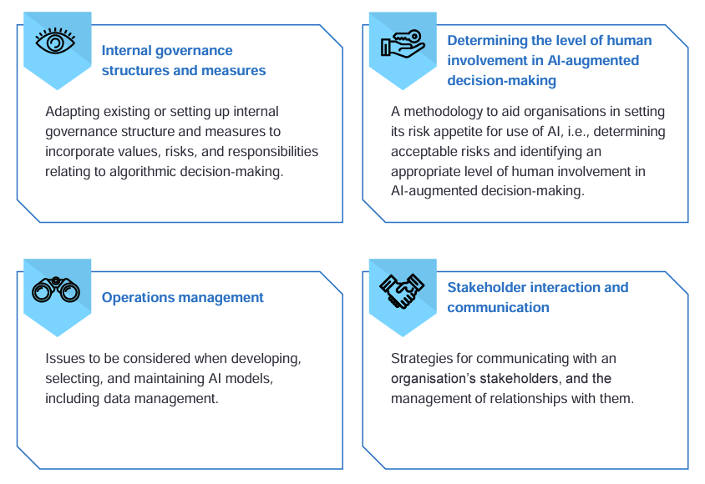

Slide 22

Human-AI Feedback Loop
Human-in-the-Loop (HITL)
Human-on-the-Loop (HOTL)
Human-out-of-the-Loop (HOVTL)
Level: Low Automation
AI cannot complete tasks without human intervention at every step.
Feedback:
Active feedback to refine the process in real-time.
Ex: Reviewing every single code AI suggests for qualitative data.
Level: Partial Automation
AI performs tasks autonomously; human monitors and can "break" the loop.
Feedback:
Evaluative feedback by auditing samples to adjust instructions.
Ex: Spot-checking 5/100 AI summaries to ensure quality.
Level: Full Automation
System is fully autonomous; humans only set parameters or review final results.
Feedback:
Post-hoc feedback affecting only future task versions.
Ex: Checking a spam folder once a month for missed emails.
Sharef, N.M. (2026)

Slide 23
Automation Levels
Advisory (Level 2-4)
Consent (Level 5-6)
Exception (Level 7-8)
Autonomous (Level 9-10)
Role: AI suggests options, human picks.
Responsibility: Very High ("Editor-in-Chief").
Postgrad Use:
Brainstorming research questions or methodologies.
Role: AI suggests action, waits for "Yes/No".
Responsibility: High ("Gatekeeper").
Postgrad Use:
Drafting emails to supervisors requiring manual "Send".
Role: AI executes, informs after or if stuck.
Responsibility: Medium (Partner's judgment).
Postgrad Use:
Automated scraping alerting only on structure changes.
Role: AI decides everything without reporting.
Responsibility: Critically Low / Dangerous.
Postgrad Use:
Avoided; violates accountability principle.
Sharef, N.M. (2026)

Slide 24
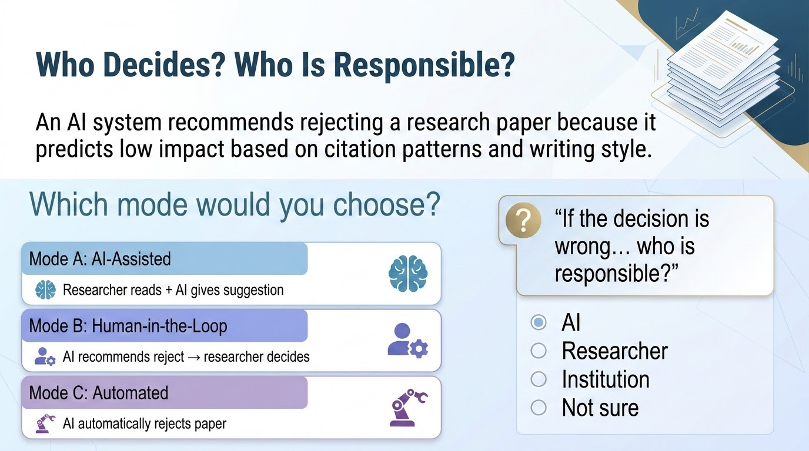

Slide 25
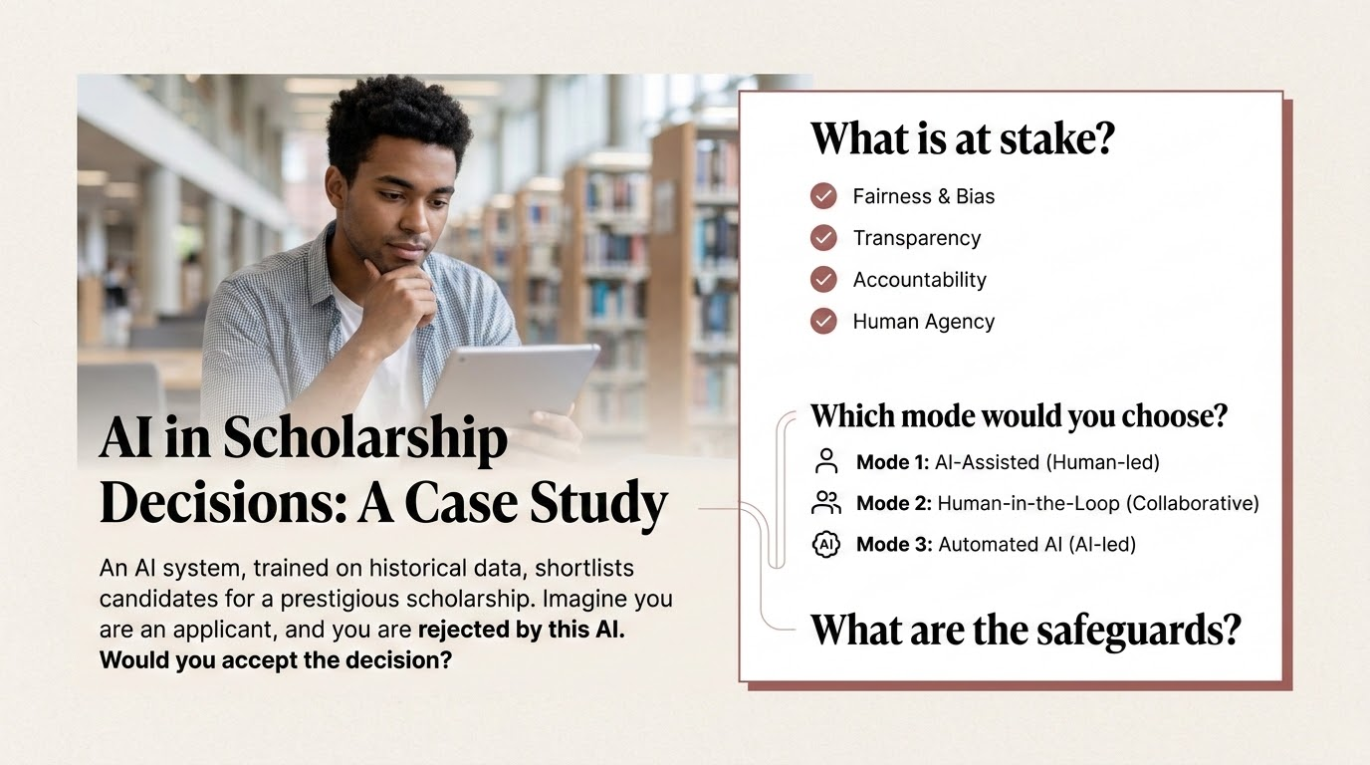

Slide 26
Part 3
AI as research decision partners
AI as Decision Partners: How Human Responsibility Shapes AI Use
Prof Ts. Dr. Nurfadhlina Mohd Sharef

Slide 27
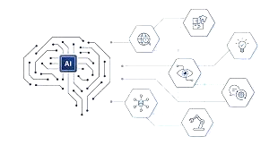



AI as Decision Partners
https://bit.ly/3Qf7odI?r=qr

Slide 28
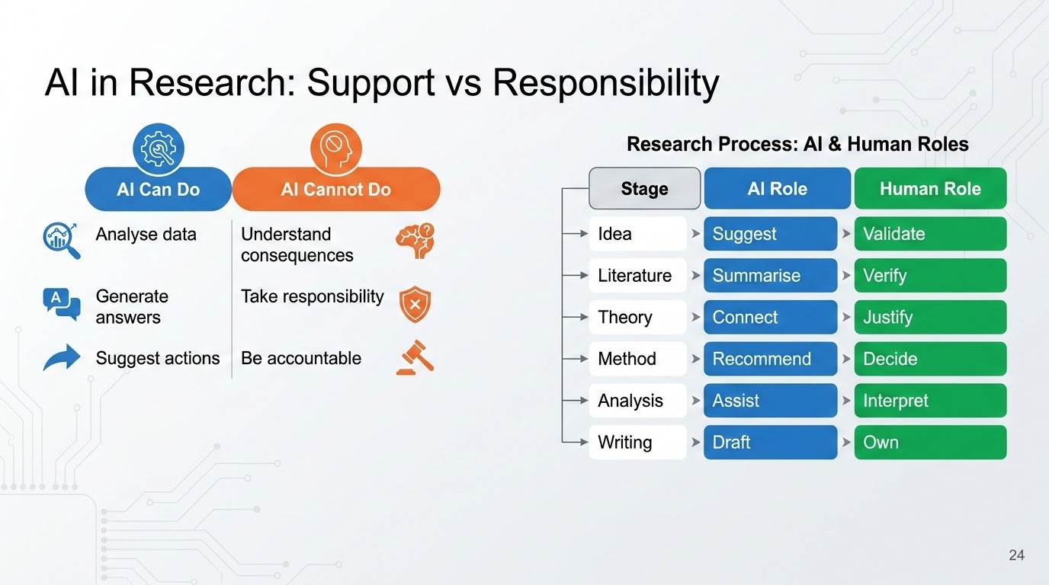

Slide 29
Research Activity | How AI is Used | Key Risk (If Misused) | Human Responsibility
Problem Identification | Generate topics, suggest research gaps, scan trends | Superficial or fabricated problems | Ensure the problem is real, relevant, and meaningful
Literature Review | Summarise papers, compare studies, suggest citations | Hallucinated or incorrect references, missing key works | Verify sources and read original papers
Conceptualisation & Theory | Suggest frameworks, variables, hypotheses | Weak logic, inconsistent or oversimplified models | Ensure theoretical soundness and coherence
Methodology Design | Recommend methods, metrics, experimental setup | Wrong method or misaligned design | Ensure method fits the research question
Data Analysis & Modelling | Generate code, suggest models, interpret outputs | Blind trust in results, hidden bias | Understand and validate the model behaviour
Results Interpretation | Generate explanations, suggest conclusions | Overclaiming, incorrect conclusions | Ensure conclusions are evidence-based
Writing & Communication | Draft text, improve language, structure arguments | Loss of originality, shallow understanding | Maintain authorship, clarity, and ownership
Ethics & Impact | Suggest ethical considerations, identify risks | Superficial ethics, ignored consequences | Ensure fairness, accountability, and societal awareness

Slide 30

Postgraduate research requires "Novelty"
In a Knowledge Gap, novelty is a New Insight/Theory.
In a Performance Gap, novelty is a Technical Innovation/New Level of Efficiency.
In a Methodological Gap, novelty is a New Way of Measuring.

Slide 31












A coming productivity boom?
GenAI for Research and Data Analysis Purpose
Automate paper summary
Suggested link to related papers
Suggested questions to dig further (eg critique to the papers, main contribution, the data used)
Answer questions about the paper in seconds!
Paraphrase
Generate code and do experiment in the cloud
Analyse data
Generate graphs
Generate queries
Generate insights

Slide 32
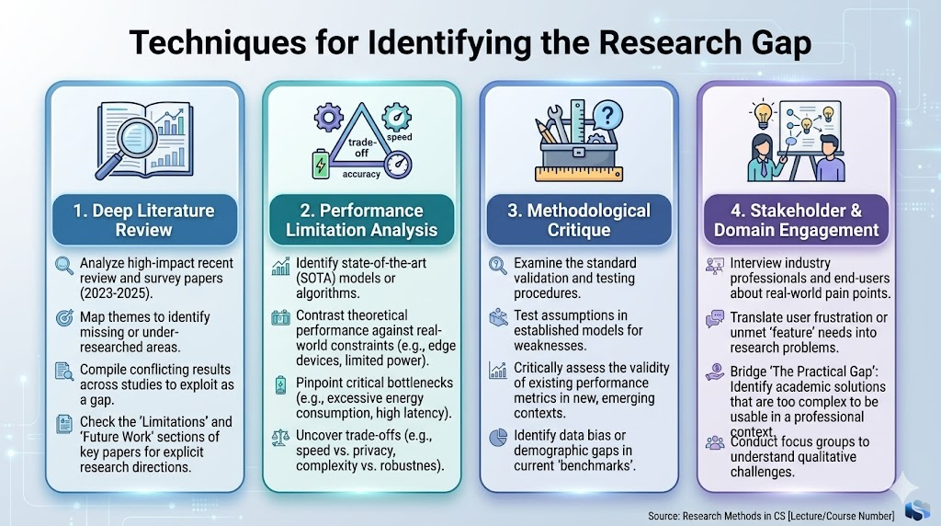
Techniques for Gap Detection

Slide 33
Techniques for Gap Detection
Identifying Research Gaps
Once you understand their problem statement, you look for what they left behind. This is how you find your own research gap
Lens & Gap Type | Scanning Focus | The Critical Question | Example Research Gap Statement
A. The "Boundary" Lens (Knowledge Gap) | Identifying unverified assumptions or untested environmental variables. | "Does this algorithm maintain its properties if the data is noisy or the network is decentralized?" | "Existing models assume idealized data; I will investigate their behavior under unreliable sensor noise."
B. The "Constraint" Lens (Performance Gap) | Detecting high-performance models that are computationally impractical for real-world deployment. | "This model achieves 99% accuracy, but can it execute locally on a power-constrained smartwatch?" | "Current SOTA models require high-end GPUs; I will develop a quantized architecture for 8-bit MCUs."
C. The "Conflict" Lens (Evidence Gap) | Finding contradictions or inconsistent results across high-impact studies. | "Paper A claims Method X is superior, while Paper B favors Method Y. What hidden variable causes this discrepancy?" | "There is a contradiction in evidence regarding privacy-utility trade-offs; I will reconcile this through a comparative study."
D. The "Outdated" Lens (Methodological Gap) | Spotting the use of legacy metrics or evaluation frameworks for emerging technologies. | "Are we still utilizing 2D screen-based metrics to quantify 'immersion' and 'presence' in spatial VR environments?" | "Current evaluation relies on subjective surveys; I will establish a biometric-based framework for objective measurement."

Slide 34

How to write your problem statement?
Self
activity
Look at your current research idea and ask yourself this question:
If I solve this, will I have created a better 'thing' (Performance), a better 'way to test the thing' (Methodological), or a better 'understanding of the thing' (Knowledge).
Most Masters students land in Performance or Application, while PhD candidates should be aiming for Knowledge or Methodological gaps.

Slide 35
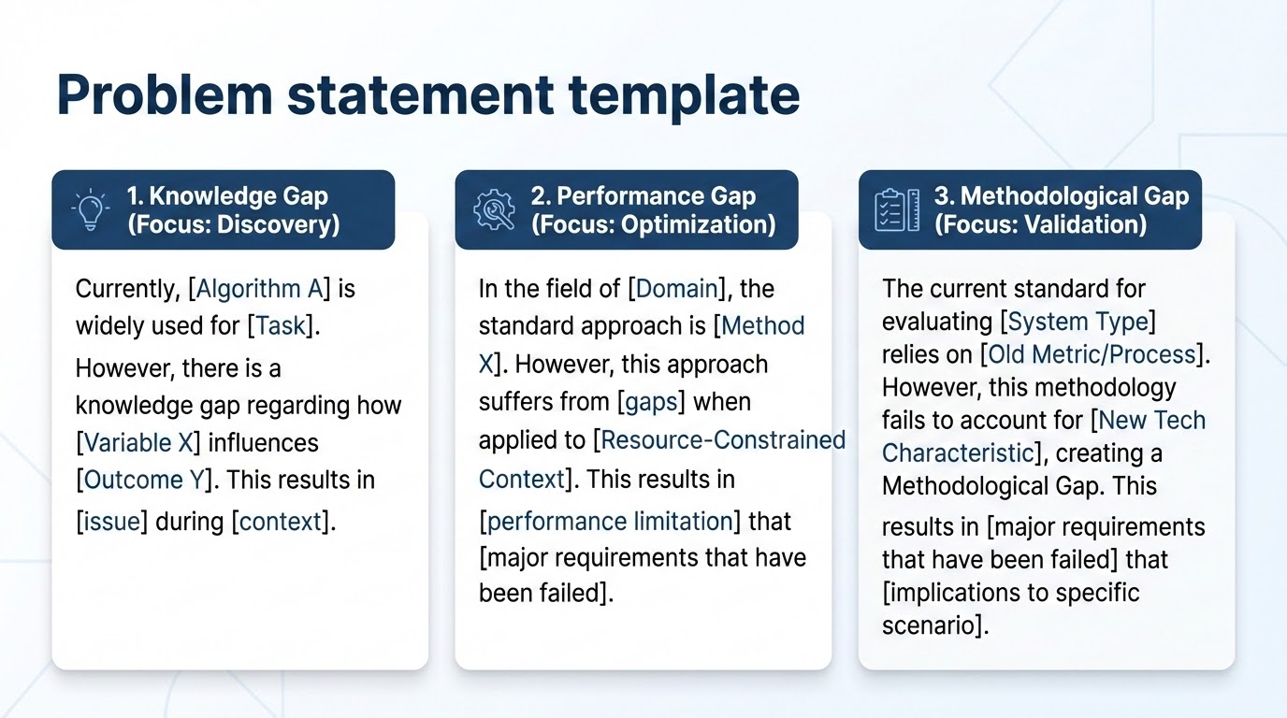

Slide 36
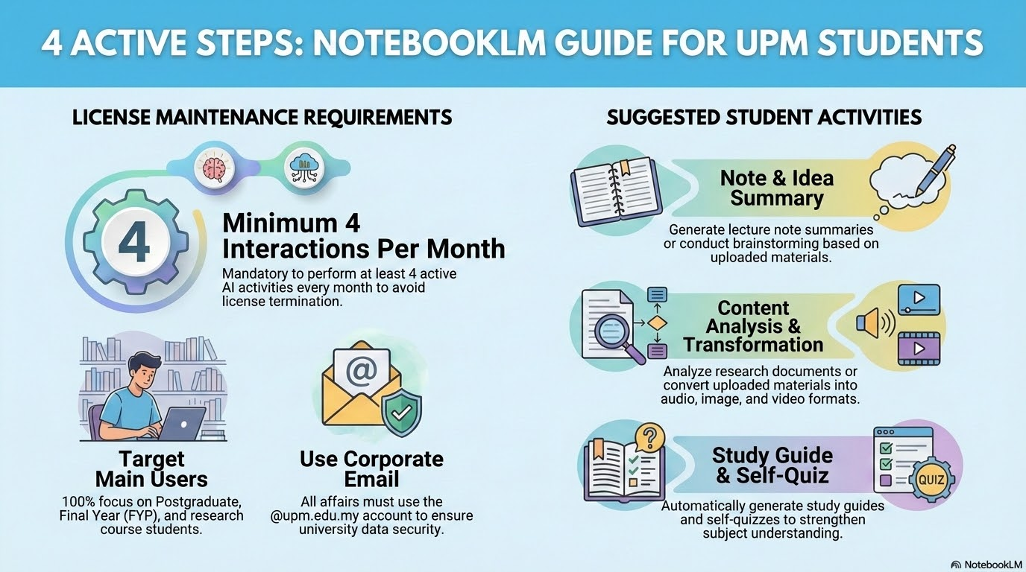

Slide 37
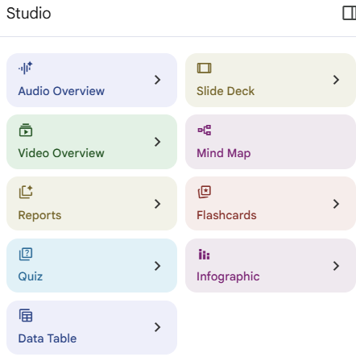
NotebookLM Studio supports 4 levels of research cognition:
1. Structuring knowledge
(Mind Map, Data Table)
2. Synthesizing knowledge
(Reports)
3. Communicating knowledge
(Slides, Infographic, Video)
4. Internalizing knowledge
(Audio, Flashcards, Quiz)

Slide 38
NotebookLM Studio Feature | Research Stage | Primary Function | Cognitive Role | How To Use It | Expected Output | Common Misuse / Risk
Mind Map | Idea Conceptualisation | Visualizes relationships between concepts | Structuring knowledge | Generate after uploading papers; identify clusters (methods, problems, variables) | Concept map of research domain | Treating it as final answer without refinement
Reports | Literature Review | Summarizes across sources | Synthesizing knowledge | Use to identify themes, trends, and gaps; compare with original papers | Draft literature synthesis | Copy-paste without critique
Audio Overview | Understanding & Reflection | Conversational explanation | Internalizing knowledge | Listen to reinforce understanding; identify unclear areas | Refined understanding notes | Passive listening without critical thinking
Video Overview | Big Picture Framing | Narrative explanation | Contextualizing knowledge | Use to understand flow of research field | Conceptual storyline of domain | Over-reliance instead of reading papers
Slide Deck | Research Proposal / Presentation | Converts content into presentation format | Communicating knowledge | Edit, justify, and defend each slide | Proposal slides / presentation deck | Submitting AI-generated slides directly
Infographic | Framework Communication | Visual abstraction of ideas | Simplifying complexity | Use to explain models/frameworks clearly | Research framework diagram | Oversimplification of complex ideas
Flashcards | Theory Mastery | Extracts key concepts | Reinforcing memory | Use for key terms, methods, theories | Concept mastery notes | Ignoring deeper understanding
Quiz | Self-Assessment | Tests understanding | Evaluating knowledge | Use to identify weak areas | Self-evaluation results | Treating as trivial exercise
Data Table | Literature Structuring (VERY IMPORTANT) | Organizes structured information | Comparing knowledge | Extract paper details (method, data, gaps) | Literature comparison table (PRISMA-ready) | Blindly trusting extracted data without checking

Slide 39
AI-Augmented Research Cognition using NotebookLM
✅ Step 1: Build a Curated Knowledge Base (KB) by each theme
Upload 5–15 key papers
Review papers + 2–3 seminal works + 2–3 recent works
Reports / datasets if relevant

Slide 40
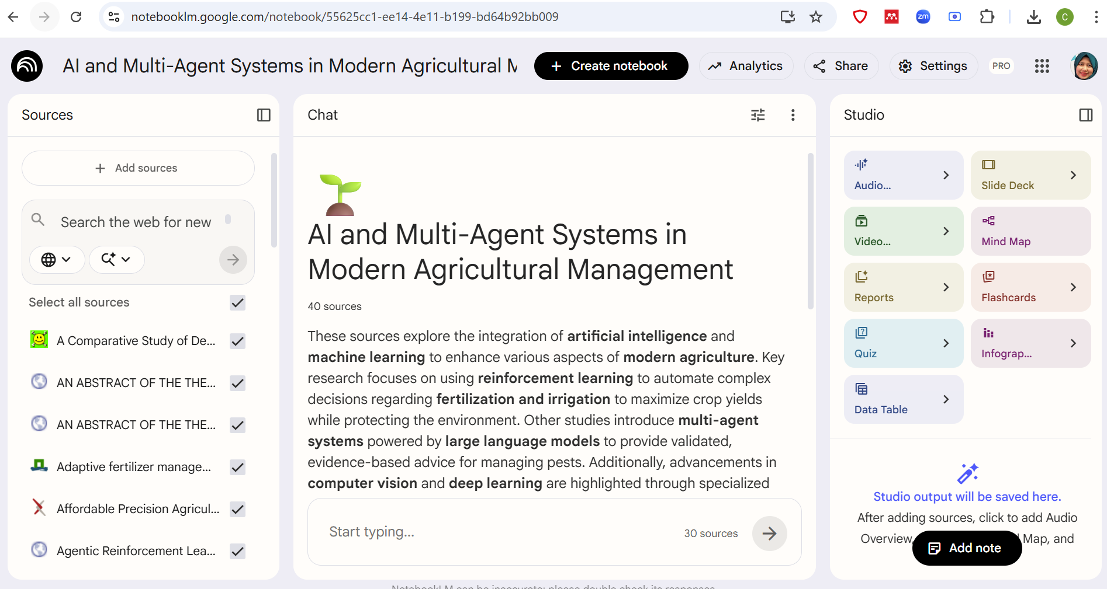
Curate your knowledge base here
Transform your thinking into structured outputs
Regard this as your thinking and analysis space

Slide 41
AI-Augmented Research Cognition using NotebookLM
Step 2: Ask High-Quality Research Questions
Instead of: ❌ “Summarize this paper”
Prompt:
“What problems are repeatedly highlighted across these papers?”
“What assumptions do existing methods rely on?”
“Where do methods fail or show limitations?”
“Compare approaches A vs B vs C in terms of weaknesses”

Slide 42
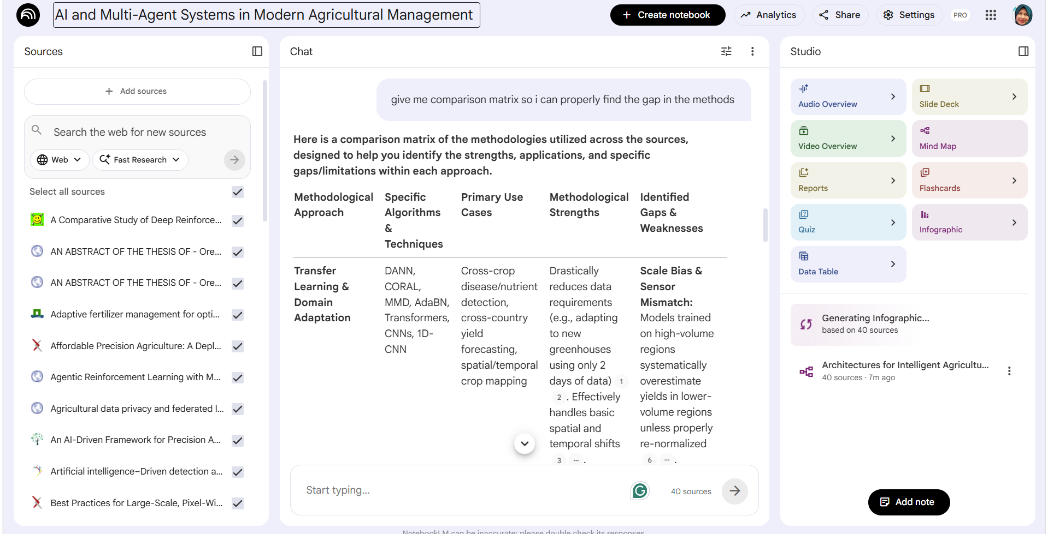

Slide 43
🔷 1. PROMPTS FOR UNDERSTANDING THE PROBLEM SPACE
Use these right after uploading papers into NotebookLM
🔹 Identify core problems
“What are the main research problems discussed across these papers?”
“What real-world challenges motivate these studies?”
“Are these problems consistent across studies or do they differ by context?”
🔹 Extract key concepts
“List the key concepts and define them in simple terms”
“What variables or factors are commonly studied?”
“How are these concepts related to each other?”
🔹 Build conceptual structure
“Group the concepts into themes or categories”
“What are the main components of the problem domain?”
“Suggest a structure for a concept map based on these papers”

Slide 44
🔷 2. PROMPTS FOR METHODS & APPROACH ANALYSIS
🔹 Identify approaches
“What methods or techniques are used to solve the problem?”
“Categorize the approaches (e.g., machine learning, simulation, rule-based, DSS)”
🔹 Compare methods
“Compare the strengths and weaknesses of each method”
“Which methods perform better under what conditions?”
“What assumptions do these approaches rely on?”
🔹 Method limitations (VERY IMPORTANT)
“What are the limitations of current approaches?”
“Where do these methods fail or underperform?”
“What challenges remain unresolved?”

Slide 45
🔷 3. PROMPTS FOR GAP IDENTIFICATION (CRITICAL STAGE)
🔹 Explicit gaps
“What gaps are explicitly mentioned in these papers?”
“What future work do the authors suggest?”
🔹 Implicit gaps (higher-level thinking)
“What important aspects are not addressed across these studies?”
“Are there missing variables, datasets, or contexts?”
“What assumptions can be challenged?”
🔹 Cross-paper gap reasoning
“What contradictions or inconsistencies exist between these papers?”
“Do different methods lead to conflicting conclusions?”
🔹 Prioritizing gaps
“Which identified gaps are most impactful and researchable?”
“Which gaps are feasible for a Master’s/PhD project?”

Slide 46
🔷 4. PROMPTS FOR IDEA GENERATION
🔹 Generate directions
“Propose 3 possible research directions based on the identified gaps”
“Suggest innovative approaches to address these gaps”
🔹 Refine problem focus
“Help me narrow down a specific research problem from these gaps”
“What would be a clear and focused research question?”
🔹 Align with contribution
“What would be the novelty of each proposed idea?”
“How does this idea differ from existing works?”

Slide 47
🔷 5. PROMPTS FOR METHODOLOGY CONSTRUCTION
🔹 Design approach
“Suggest a methodology to address this research problem”
“What type of model/framework would be suitable?”
🔹 Data & experiment design
“What data would be required for this research?”
“How should the experiment be designed?”
“What baselines should be used for comparison?”
🔹 Evaluation
“What evaluation metrics are appropriate?”
“How can I validate the effectiveness of my approach?”

Slide 48
🔷 6. PROMPTS FOR CRITICAL THINKING (VERY IMPORTANT)
🔹 Challenge your own idea
“What are the weaknesses of my proposed idea?”
“What risks or limitations might arise?”
🔹 Alternative perspectives
“What alternative approaches could solve this problem?”
“Why might my approach not be the best?”
🔹 Bias & assumptions
“What biases exist in the datasets or methods used?”
“What assumptions am I making that may not hold?”

Slide 49
🔷 8. PROMPTS FOR WRITING PREPARATION
🔹 Problem statement
“Draft a problem statement based on these gaps”
“Why is this problem important?”
🔹 Literature synthesis
“Summarize how existing works address this problem”
“What is the overall trend in this research area?”
🔹 Contribution framing
“What are the key contributions of my proposed work?”
“How does my work advance the field?”

Slide 50
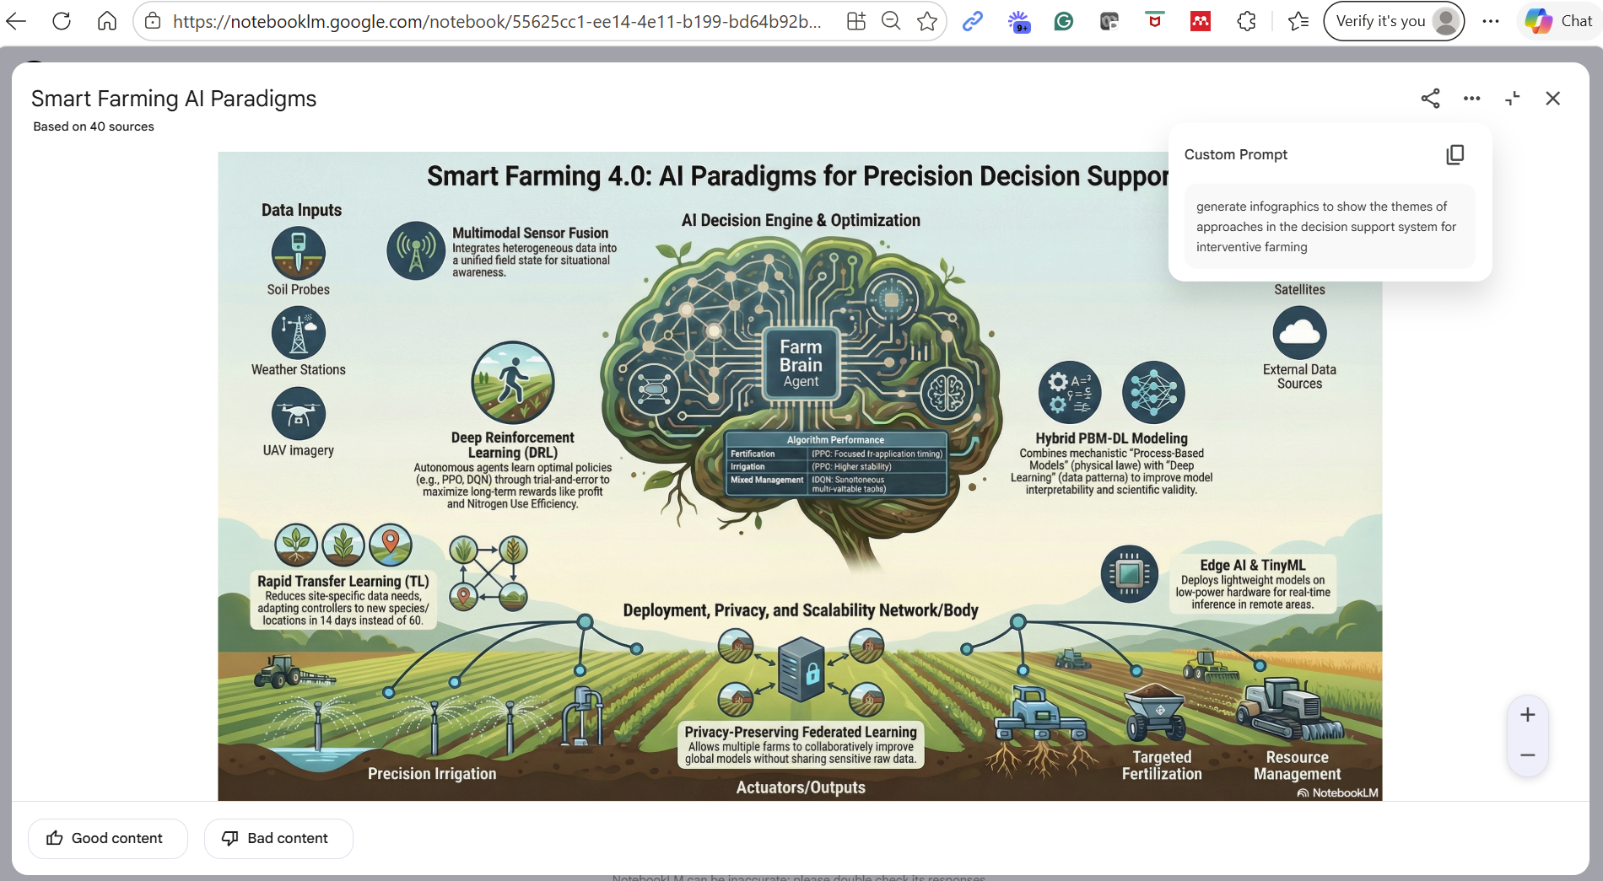

Slide 52
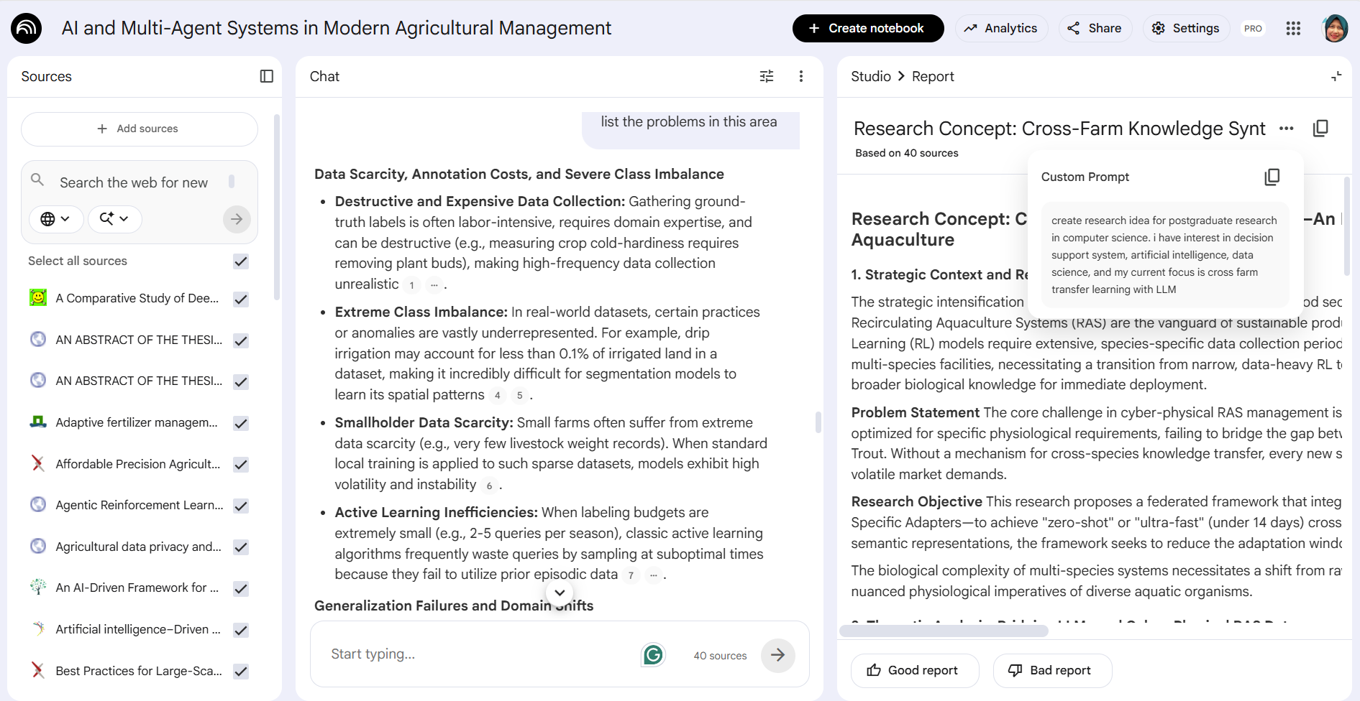

Slide 53
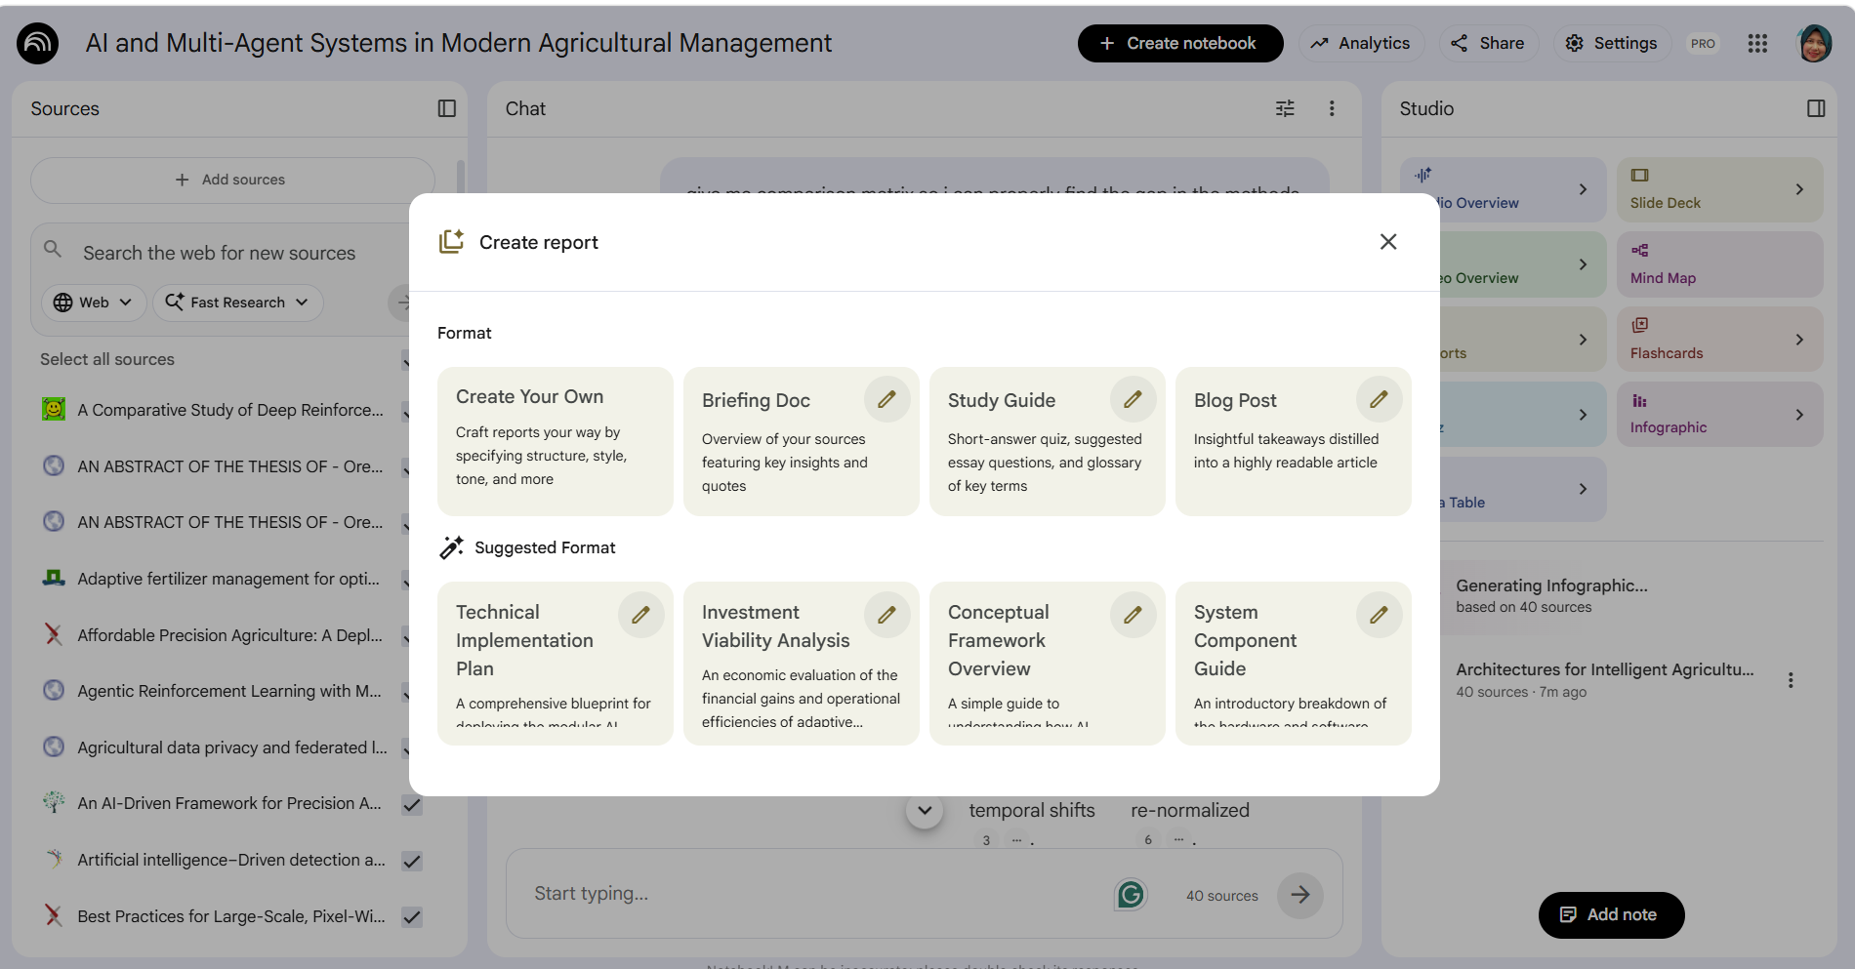

Slide 54
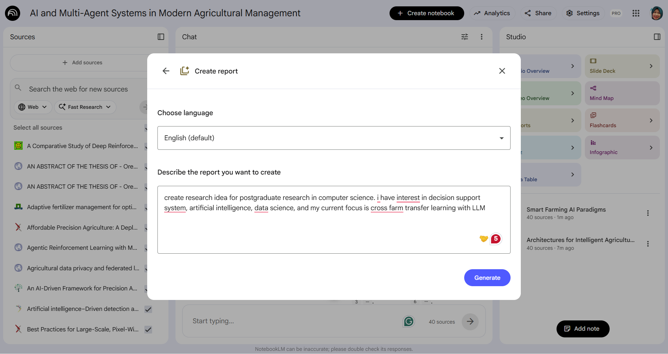

Slide 55
AI-Augmented Research Cognition using NotebookLM
Step 3: Extract Problem Space & Concept Map
Ask NotebookLM:
“List key concepts and their relationships”
“Group methods into categories”
“What are the dominant research paradigms?”
Then:
Convert outputs into concept map
Identify:
Problem domain
Methods
Variables
Outcomes

Slide 56
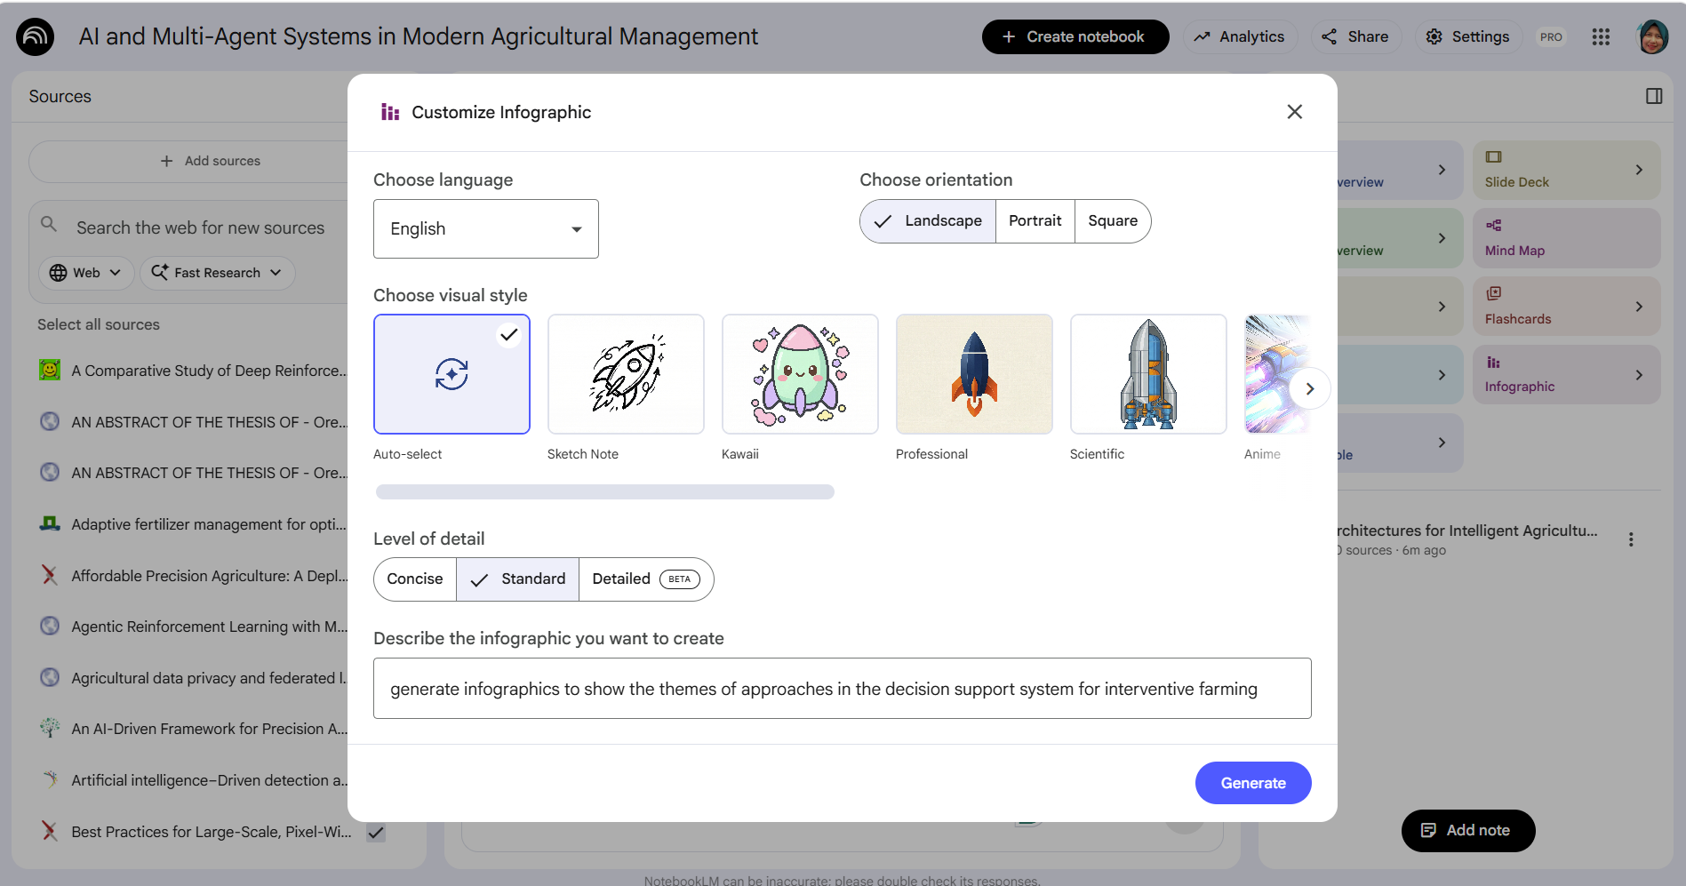

Slide 57
Part 4
Trust sovereignty in research
AI as Decision Partners: How Human Responsibility Shapes AI Use
Prof Ts. Dr. Nurfadhlina Mohd Sharef

Slide 58
Reproducible AI
Reproducibility is the ability of independent researchers to draw the same conclusions from an experiment by relying on the documentation shared by the original researchers when following the scientific method. The documentation relied on by the independent researchers specifies the type of reproducibility study, and the way the independent researchers reached their conclusion specifies to which degree the reproducibility study validated the conclusion (Gundersen, 2021).
Outcome reproducible
Analysis reproducible
Inferentially reproducible
Src: https://www.oecd-ilibrary.org/docserver/3f57323a-en.pdf?expires=1697724601&id=id&accname=guest&checksum=A2FBDF391117ED043EFA6957FB6D219C

Slide 59
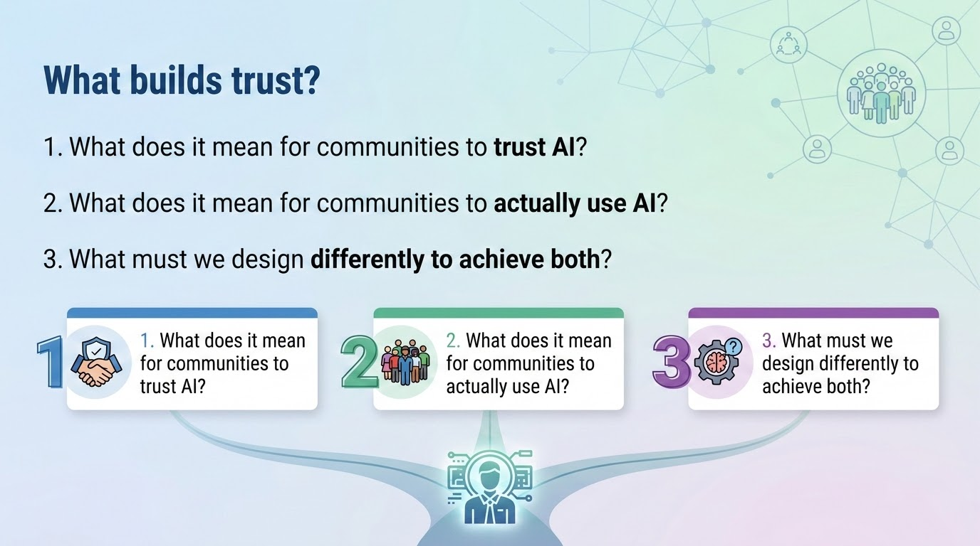

Slide 60
Risk 1: Loss of serendipity?
missing the small details in a full paper that might spark a new original thought.
A student uses an AI to find and summarize 20 papers for a literature review. The AI does a perfect job, and the student verifies every citation. However, the student never actually read the full-text versions of 15 of those papers because the AI summaries were 'good enough' to write the chapter.
Ghost of literature review?

Slide 61
Risk 2: Dignity and Representation
A researcher uses AI to anonymize and 'clean up' the grammar of interview transcripts from a community with a specific dialect to make the report 'more professional' for their committee. The AI inadvertently changes the cultural tone of the responses.
Would the cultural uniqueness be faded?

Slide 62
Risk 3: Reasoning gap
You upload your raw lab data to a specialized AI tool. The AI finds a significant correlation that you didn't see. You include this finding in your paper. During your viva, the examiner asks you to explain the statistical logic behind that specific correlation, but you can't because the AI 'just found it'
Research validity and reliability could be argued

Slide 63
Risk 4: Privacy and Data Sovereignty
To save time, a medical postgrad enters de-identified patient symptoms into a public AI to get a list of rare potential diagnoses. The data contains no names, but the combination of rare symptoms could theoretically identify the individual.
Medical data protection?

Slide 64
Part 5
Conclusion and our role
AI as Decision Partners: How Human Responsibility Shapes AI Use
Prof Ts. Dr. Nurfadhlina Mohd Sharef

Slide 65
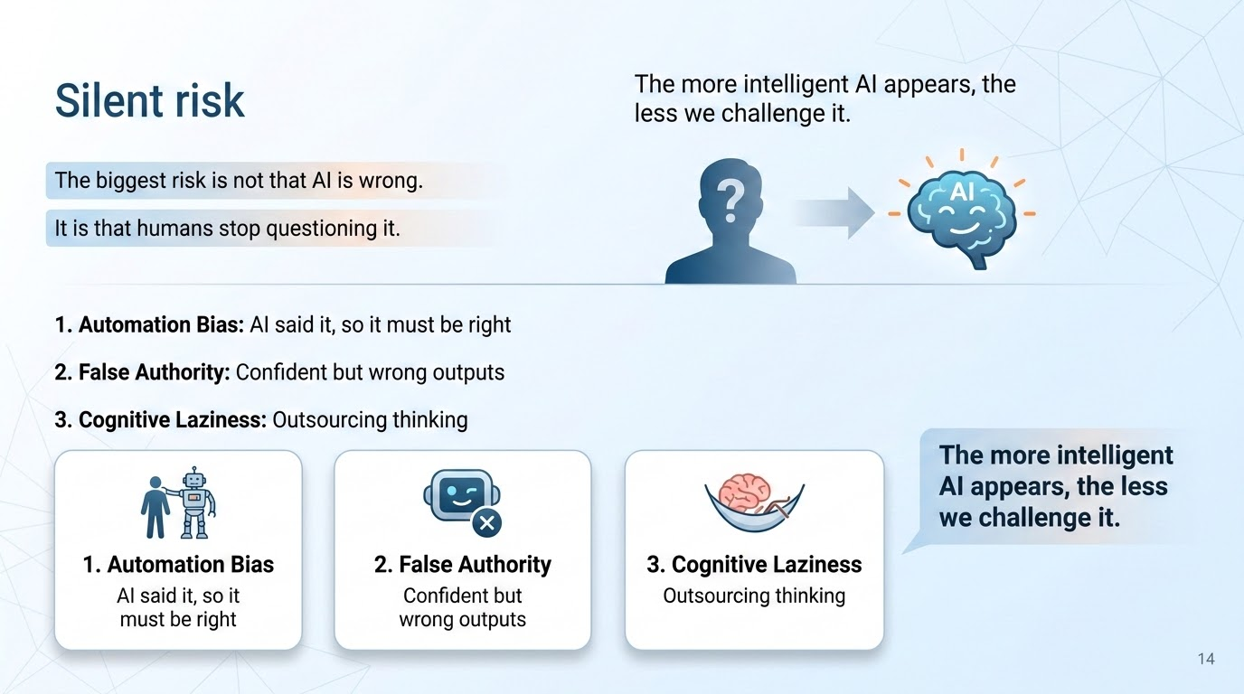

Slide 66
A piece of my personal experience
AI will not replace the core responsibility of my research tasks such as stakeholder communication, defining the right questions, building trust with teams and driving adoption of insights
AI can help me brainstorm, it can help me move faster, but it still depends heavily on the context I provide.
Most of the time, I’m the one guiding the process and setting the constraints. In other words, AI speeds up the work, but the judgment still sits with me.

Slide 67
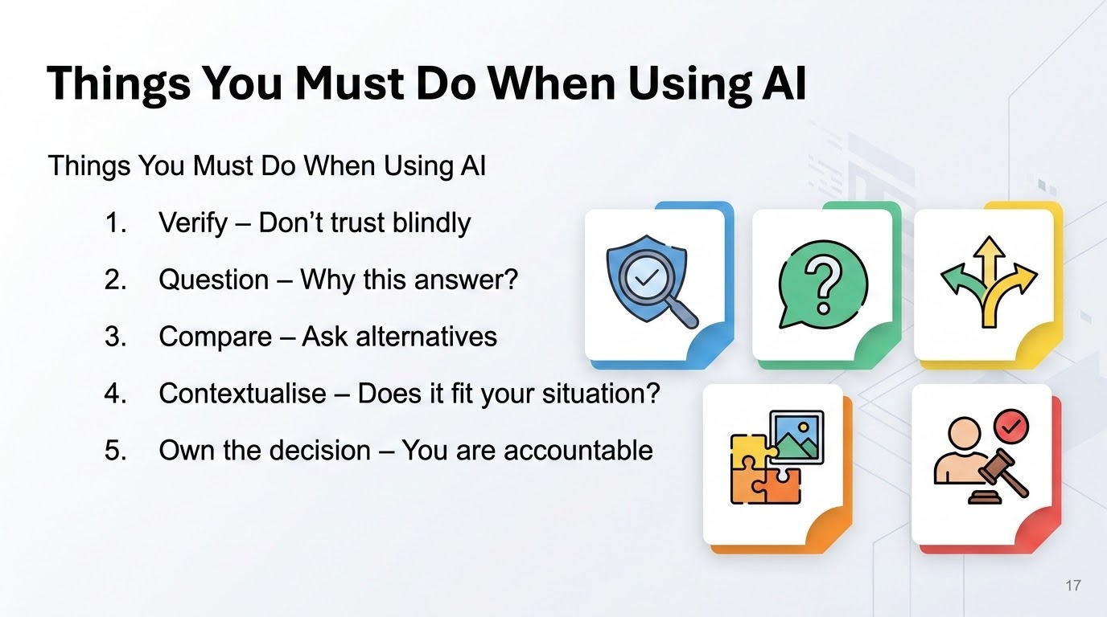

Slide 68
Why AI often fails in the real world
High-performing models ≠ trusted systems
AI optimised for accuracy, not decision reality
Governance, context, and human agency are often afterthoughts
Communities are expected to adapt to AI, not the other way around
Most AI failures are
not technical failures
they are decision failures
Sharef, N.M. (2026)

Slide 69
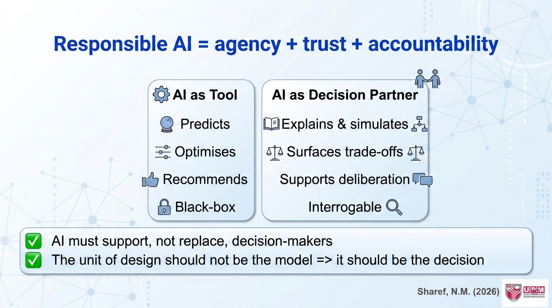

Slide 70




THANKS!
Integrity gives direction
Responsibility discipline
Adaptivity resilience
Empathy humanity
Evidence wisdom
Nurfadhlina Mohd Sharef
nurfadhlina@upm.edu.my
www.upm.edu.my

